Slide 1
Module 6: Configuring and Managing Virtual Storage

Slide 2
Importance
Understanding the available storage options helps you set up your storage according to your cost, performance, and manageability requirements.
You can use shared storage for disaster recovery, high availability, and moving virtual machines between hosts.

Slide 3
Module Lessons
Storage Concepts
Fibre Channel Storage
iSCSI Storage
VMFS Datastores
NFS Datastores
vSAN Datastores

Slide 4
Virtual Beans: Storage
Virtual Beans current storage infrastructure consists of NAS storage and iSCSI storage arrays.
Virtual Beans has the following goals for its storage infrastructure:
Run the production and development workloads on shared storage systems.
Use existing NAS and iSCSI storage arrays in the vSphere environment.
These arrays are managed by the storage administrator at Virtual Beans.
Evaluate other options in vSphere 7 for cost-effective, high-performance storage.
As a Virtual Beans vSphere administrator, you must configure storage for use in the vSphere environment and provide recommendations to management on other storage options in vSphere 7.

Slide 5

Lesson 1: Storage Concepts

Slide 6
Learner Objectives
After completing this lesson, you should be able to meet the following objectives:
Recognize vSphere storage technologies
Identify types of datastores

Slide 7
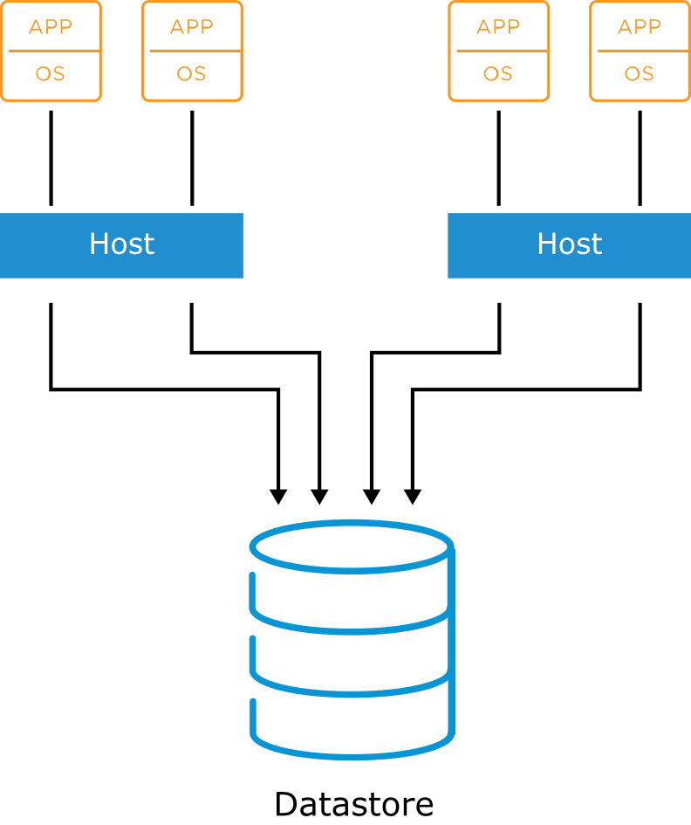
About Datastores
A datastore is a logical storage unit that can use disk space on one physical device or span several physical devices.
Datastores are used to hold VM files, VM templates, and ISO images.
vSphere supports the following types of datastores:
VMFS
NFS
vSAN
vSphere Virtual Volumes
Notes:
A datastore is a generic term for a container that holds files and objects. Datastores are logical containers, analogous to file systems, that hide the specifics of each storage device and provide a uniform model for storing virtual machine files. A VM is stored as a set of files in its own directory or as a group of objects in a datastore.
You can display all datastores that are available to your hosts and analyze their properties.

Slide 8
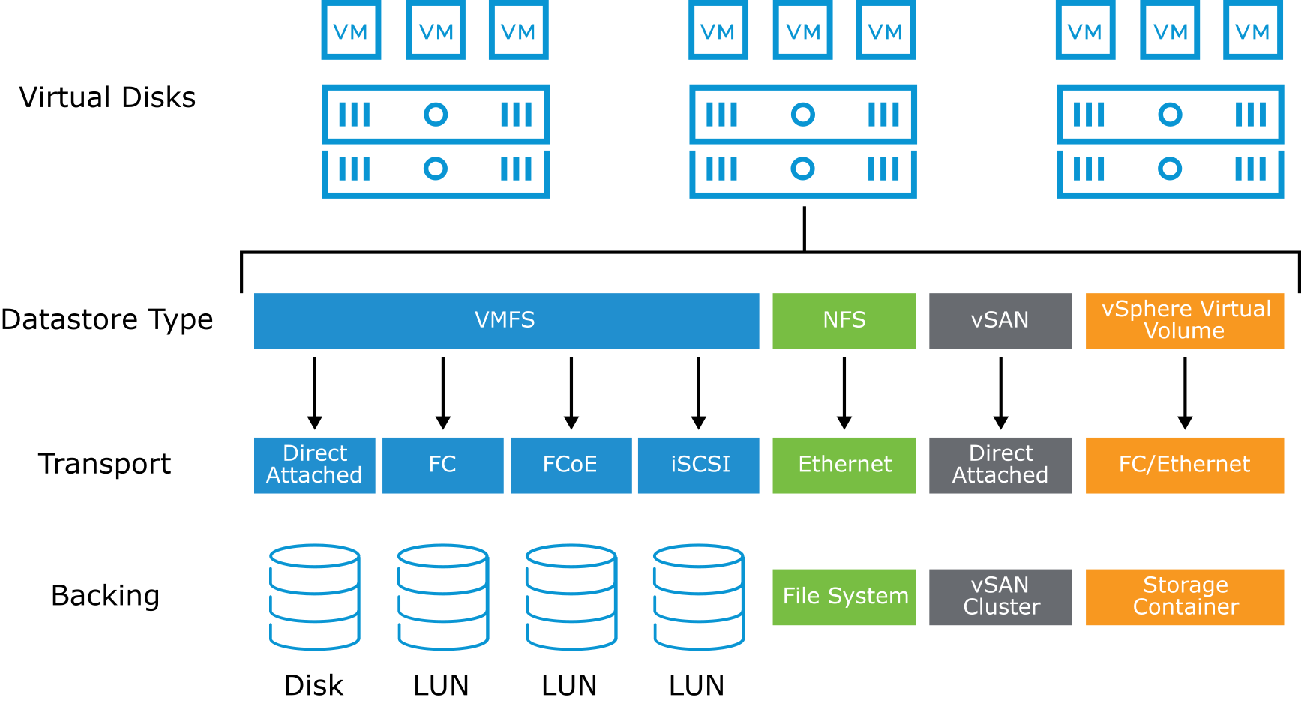
Storage Overview
ESXi hosts should be configured with shared access to datastores.
Notes:
Depending on the type of storage that you use, datastores can be formatted with VMFS or NFS.
In the vSphere environment, ESXi hosts support several storage technologies:
Direct-attached storage: Internal or external storage disks or arrays attached to the host through a direct connection instead of a network connection.
Fibre Channel (FC): A high-speed transport protocol used for SANs. Fibre Channel encapsulates SCSI commands, which are transmitted between Fibre Channel nodes. In general, a Fibre Channel node is a server, a storage system, or a tape drive. A Fibre Channel switch interconnects multiple nodes, forming the fabric in a Fibre Channel network.
FCoE: The Fibre Channel traffic is encapsulated into Fibre Channel over Ethernet (FCoE) frames. These FCoE frames are converged with other types of traffic on the Ethernet network.
iSCSI: A SCSI transport protocol, providing access to storage devices and cabling over standard TCP/IP networks. iSCSI maps SCSI block-oriented storage over TCP/IP. Initiators, such as an iSCSI host bus adapter (HBA) in an ESXi host, send SCSI commands to targets, located in iSCSI storage systems.
NAS: Storage shared over standard TCP/IP networks at the file system level. NAS storage is used to hold NFS datastores. The NFS protocol does not support SCSI commands.
iSCSI, network-attached storage (NAS), and FCoE can run over high-speed networks providing increased storage performance levels and ensuring sufficient bandwidth. With sufficient bandwidth, multiple types of high-bandwidth protocol traffic can coexist on the same network. r For more information about physical NIC support and maximum ports supported, see VMware Configuration Maximums at https://configmax.vmware.com.

Slide 9
Storage Protocol Overview
Each datastore uses a protocol with varying support features.
Datastore Type | Storage Protocol | Boot from SAN Support | vSphere vMotion Support | vSphere HA Support | vSphere DRS Support
VMFS | Fibre Channel | Yes | Yes | Yes | Yes
 | FCoE | Yes | Yes | Yes | Yes
 | iSCSI | Yes | Yes | Yes | Yes
 | iSER/NVMe-oF (RDMA) | No | Yes | Yes | Yes
 | DAS (SAS, SATA, NVMe) | N/A | Yes* | No | No
NFS | NFS | No | Yes | Yes | Yes
vSphere Virtual Volumes | FC/Ethernet (iSCSI, NFS) | No | Yes | Yes | Yes
vSAN Datastore | vSAN | No | Yes | Yes | Yes
Notes:
* Direct-attached storage (DAS) supports vSphere vMotion when combined with vSphere Storage vMotion.
Direct-attached storage, as opposed to SAN storage, is where many administrators install ESXi. Direct-attached storage is also ideal for small environments because of the cost savings associated with purchasing and managing a SAN. The drawback is that you lose many of the features that make virtualization a worthwhile investment, for example, balancing the workload on a specific ESXi host. Direct-attached storage can also be used to store noncritical data:
CD/DVD ISO images
Decommissioned VMs
VM templates
In comparison, storage LUNs must be pooled and shared so that all ESXi hosts can access them. Shared storage provides the following vSphere features:
vSphere vMotion
vSphere HA
vSphere DRS
Using shared SAN storage also provides robust features in vSphere:
Central repositories for VM files and templates
Clustering of VMs across ESXi hosts
Allocation of large amounts (terabytes) of storage to your ESXi hosts
ESXi supports different methods of booting from the SAN to avoid handling the maintenance of additional direct-attached storage or if you have diskless hardware configurations, such as blade systems. If you set up your host to boot from a SAN, your host’s boot image is stored on one or more LUNs in the SAN storage system. When the host starts, it boots from the LUN on the SAN rather than from its direct-attached disk.
For ESXi hosts, you can boot from software iSCSI, a supported independent hardware SCSI adapter, and a supported dependent hardware iSCSI adapter. The network adapter must support only the iSCSI Boot Firmware Table (iBFT) format, which is a method of communicating parameters about the iSCSI boot device to an operating system.

Slide 10
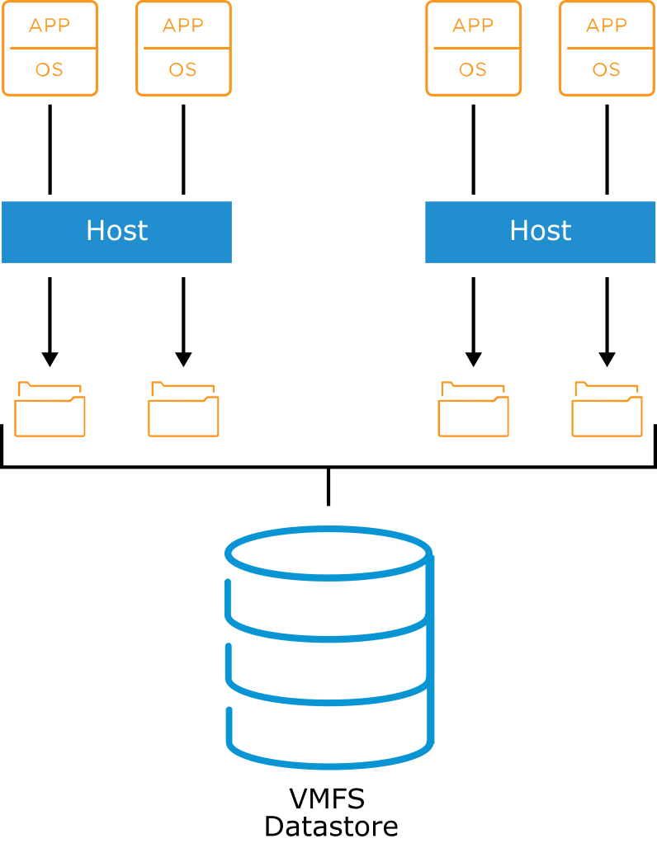
About VMFS
ESXi hosts support VMFS5 and VMFS6:
Features supported by both VMFS5 and VMFS6:
Concurrent access to shared storage
Dynamic expansion
On-disk locking
Features supported by VMFS6:
4K native storage devices
Automatic space reclamation
Notes:
VMFS is a clustered file system where multiple ESXi hosts can read and write to the same storage device simultaneously. The clustered file system provides unique, virtualization-based services:
Migration of running VMs from one ESXi host to another without downtime
Automatic restarting of a failed VM on a separate ESXi host
Clustering of VMs across various physical servers
Using VMFS, IT organizations can simplify VM provisioning by efficiently storing the entire VM state in a central location. Multiple ESXi hosts can access shared VM storage concurrently.
The size of a VMFS datastore can be increased dynamically when VMs residing on the VMFS datastore are powered on and running. A VMFS datastore efficiently stores both large and small files belonging to a VM. A VMFS datastore can support virtual disk files. A virtual disk file has a maximum of 62 TB. A VMFS datastore uses subblock addressing to make efficient use of storage for small files.
VMFS provides block-level distributed locking to ensure that the same VM is not powered on by multiple servers at the same time. If an ESXi host fails, the on-disk lock for each VM is released and VMs can be restarted on other ESXi hosts.
On the slide, each ESXi host has two VMs running on it. The lines connecting the VMs to the VM disks (VMDKs) are logical representations of the association and allocation of the larger VMFS datastore. The VMFS datastore includes one or more LUNs. The VMs see the assigned storage volume only as a SCSI target from within the guest operating system. The VM contents are only files on the VMFS volume.
VMFS can be deployed on three kinds of SCSI-based storage devices:
Direct-attached storage
Fibre Channel storage
iSCSI storage
A virtual disk stored on a VMFS datastore always appears to the VM as a mounted SCSI device. The virtual disk hides the physical storage layer from the VM's operating system.
For the operating system in the VM, VMFS preserves the internal file system semantics. As a result, the operating system running in the VM sees a native file system, not VMFS. These semantics ensure correct behavior and data integrity for applications running on the VMs.

Slide 11
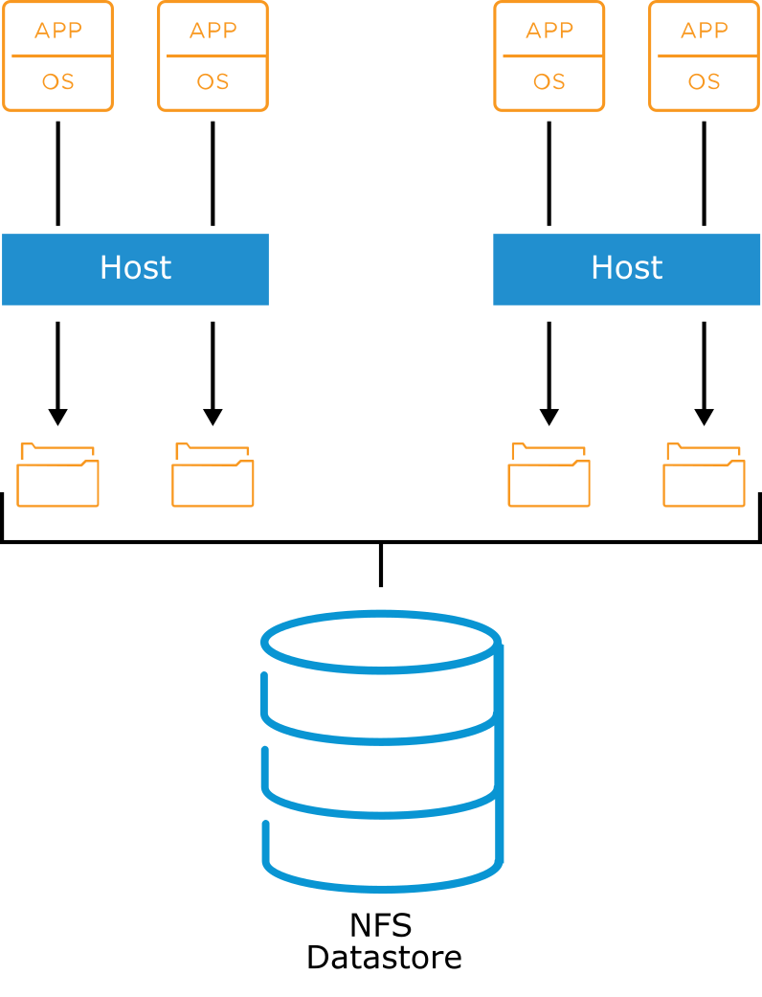
About NFS
NFS is a file-sharing protocol that ESXi hosts use to communicate with a network-attached storage (NAS) device.
NFS supports NFS 3 and 4.1 over TCP/IP.
Notes:
NAS is a specialized storage device that connects to a network and can provide file access services to ESXi hosts.
NFS datastores are treated like VMFS datastores because they can hold VM files, templates, and ISO images. In addition, like a VMFS datastore, an NFS volume allows the vSphere vMotion migration of VMs whose files reside on an NFS datastore. The NFS client built in to ESXi uses NFS protocol versions 3 and 4.1 to communicate with the NAS or NFS servers.
ESXi hosts do not use the Network Lock Manager protocol, which is a standard protocol that is used to support the file locking of NFS-mounted files. VMware has its own locking protocol. NFS 3 locks are implemented by creating lock files on the NFS server. NFS 4.1 uses server-side file locking.
Because NFS 3 and NFS 4.1 clients do not use the same locking protocol, you cannot use different NFS versions to mount the same datastore on multiple hosts. Accessing the same virtual disks from two incompatible clients might result in incorrect behavior and cause data corruption.

Slide 12
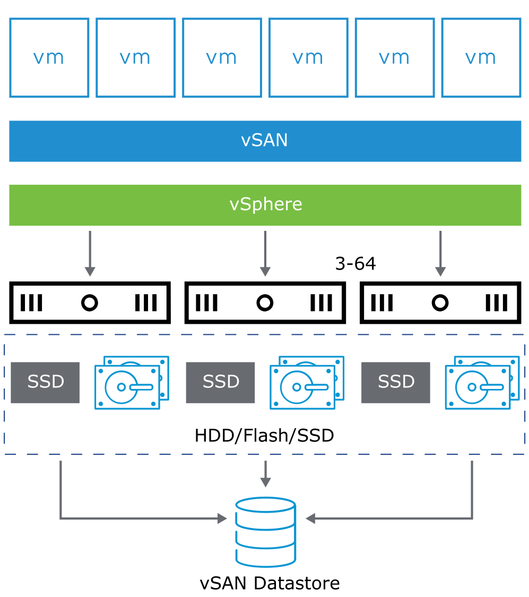
About vSAN
vSAN is hypervisor-converged, software-defined storage for virtual environments that does not use traditional external storage.
By clustering host-attached hard disk drives (HDDs) or solid-state drives (SSDs), vSAN creates an aggregated datastore shared by VMs.
Notes:
When vSAN is enabled on a cluster, a single vSAN datastore is created. This datastore uses the storage components of each host in the cluster.
vSAN can be configured as hybrid or all-flash storage. In a hybrid storage architecture, vSAN pools server-attached HDDs and SSDs to create a distributed shared datastore. This datastore abstracts the storage hardware to provide a software-defined storage tier for VMs. Flash is used as a read cache/write buffer to accelerate performance, and magnetic disks provide capacity and persistent data storage. Alternately, vSAN can be deployed as an all-flash storage architecture in which flash devices are used as a write cache. SSDs provide capacity, data persistence, and consistent, fast response times. In the all-flash architecture, the tiering of SSDs results in a cost-effective implementation: a write-intensive, enterprise-grade SSD cache tier and a read-intensive, lower-cost SSD capacity tier.

Slide 13
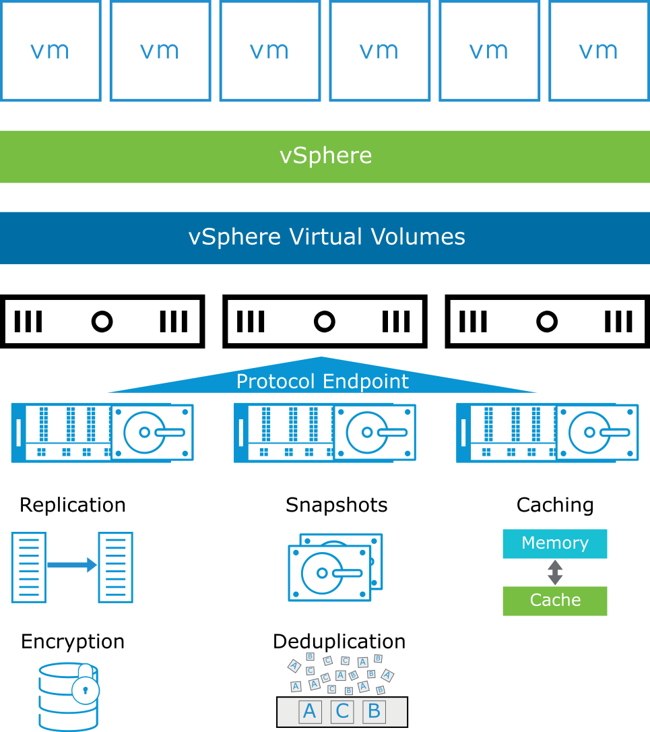
About vSphere Virtual Volumes
vSphere Virtual Volumes provides several functionalities:
Native representation of VMDKs on SAN/NAS: No LUNs or volume management
Works with existing SAN/NAS systems
A new control path for data operations at the VM and VMDK level
Snapshots, replications, and other operations at the VM level on external storage
Automates control of per-VM service levels by using storage policies
Standard access to storage with the vSphere API for Storage Awareness protocol endpoint
Storage containers that span an entire array
Notes:
vSphere Virtual Volumes virtualizes SAN and NAS devices by abstracting physical hardware resources into logical pools of capacity.
vSphere Virtual Volumes provides the following benefits:
Lower storage cost
Reduced storage management overhead
Greater scalability
Better response to data access and analytical requirements

Slide 14
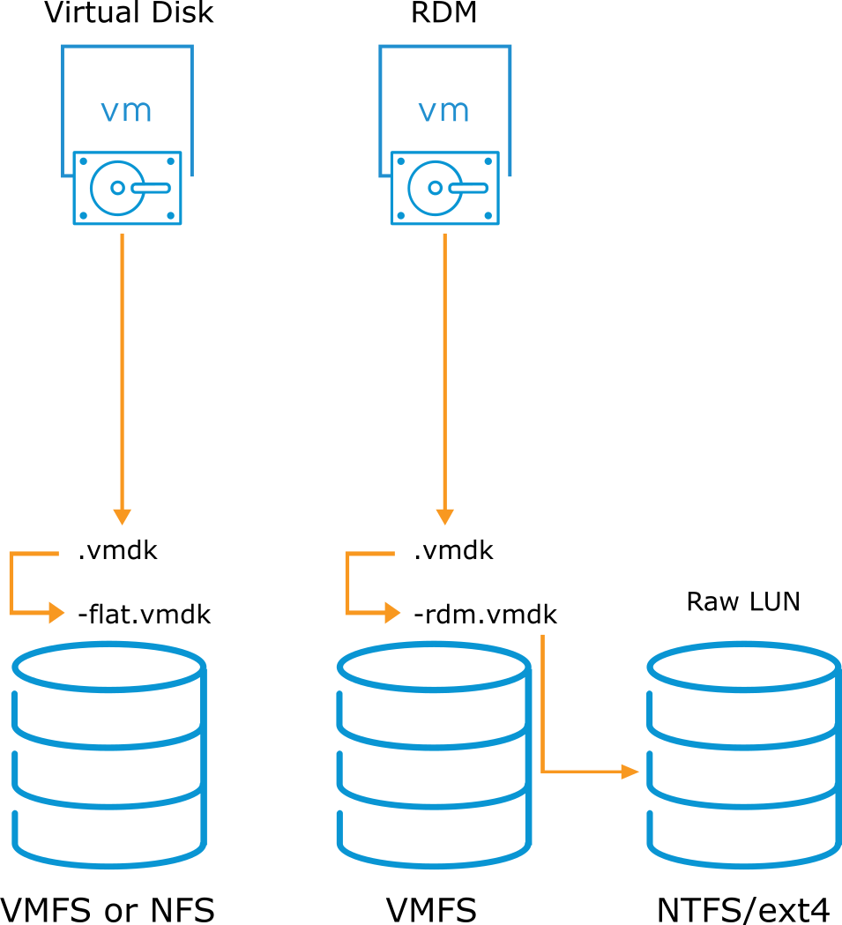
About Raw Device Mapping
Although not a datastore, raw device mapping (RDM) gives a VM direct access to a physical LUN.
The mapping file (-rdm.vmdk) that points a VM to a LUN must be stored on a VMFS datastore.
Notes:
Raw device mapping (RDM) is a file stored in a VMFS volume that acts as a proxy for a raw physical device.
Instead of storing VM data in a virtual disk file that is stored on a VMFS datastore, you can store the guest operating system data directly on a raw LUN. Storing the data is useful if you run applications in your VMs that must know the physical characteristics of the storage device. By mapping a raw LUN, you can use existing SAN commands to manage storage for the disk.
Use RDM when a VM must interact with a real disk on the SAN. This condition occurs when you make disk array snapshots or have a large amount of data that you do not want to move onto a virtual disk as a part of a physical-to-virtual conversion.

Slide 15
Physical Storage Considerations
Before implementing your vSphere environment, discuss the storage needs with your storage administration team. Consider the following factors:
LUN sizes
I/O bandwidth required by your applications
I/O requests per second that a LUN is capable of
Disk cache parameters
Zoning and masking
Multipathing setting for your storage arrays (active-active or active-passive)
Export properties for NFS datastores
Notes:
For information to help you plan for your storage needs, see vSphere Storage at https://docs.vmware.com/en/VMware-vSphere/7.0/com.vmware.vsphere.storage.doc/GUID-8AE88758-20C1-4873-99C7-181EF9ACFA70.html. Another good source of information is the vSphere Storage page at https://storagehub.vmware.com/.

Slide 16
Review of Learner Objectives
After completing this lesson, you should be able to meet the following objectives:
Recognize vSphere storage technologies
Identify types of datastores

Slide 17
Lesson 2: Fibre Channel Storage

Slide 18
Learner Objectives
After completing this lesson, you should be able to meet the following objectives:
Describe uses of Fibre Channel with ESXi
Identify Fibre Channel components and addressing
Explain how multipathing with Fibre Channel works

Slide 19
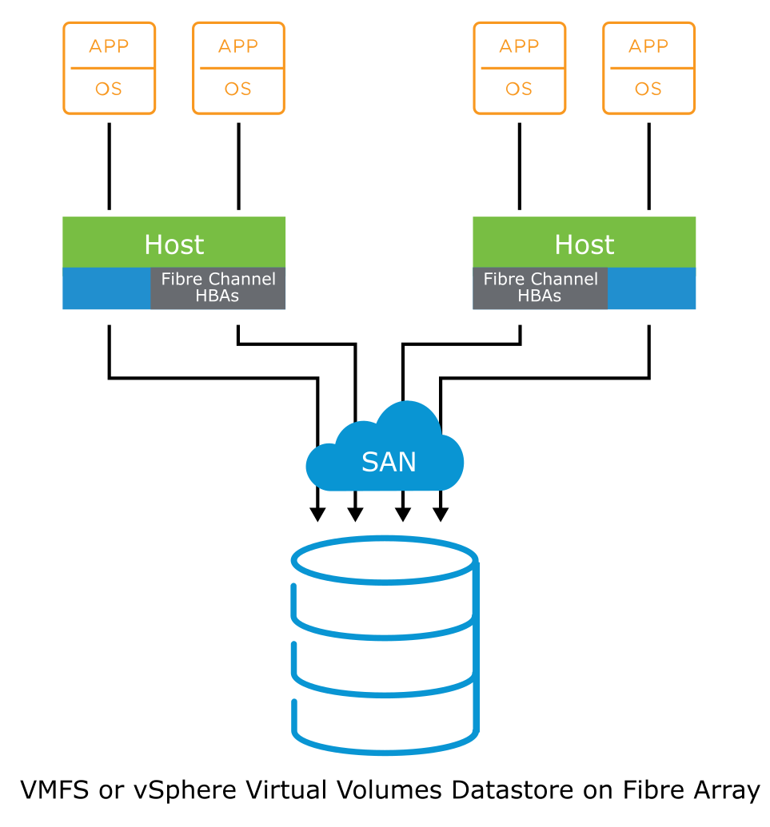
About Fibre Channel
Fibre Channel stores VM files remotely on a Fibre Channel SAN.
A Fibre Channel SAN is a specialized high-speed network that connects your hosts to high-performance storage devices.
The network uses the Fibre Channel protocol to transport SCSI traffic from VMs to the Fibre Channel SAN devices.
ESXi supports:
32 Gbps Fibre Channel
Fibre Channel over Ethernet (FCoE)
Notes:
To connect to the Fibre Channel SAN, your host should be equipped with Fibre Channel host bus adapters (HBAs).
Unless you use Fibre Channel direct connect storage, you need Fibre Channel switches to route storage traffic. If your host contains FCoE adapters, you can connect to your shared Fibre Channel devices by using an Ethernet network.
In this configuration, a host connects to a SAN fabric, which consists of Fibre Channel switches and storage arrays, using a Fibre Channel adapter. LUNs from a storage array become available to the host. You can access the LUNs and create datastores for your storage needs. These datastores use the VMFS format. Alternatively, you can access a storage array that supports vSphere Virtual Volumes and create vSphere Virtual Volumes datastores on the array’s storage containers.

Slide 20
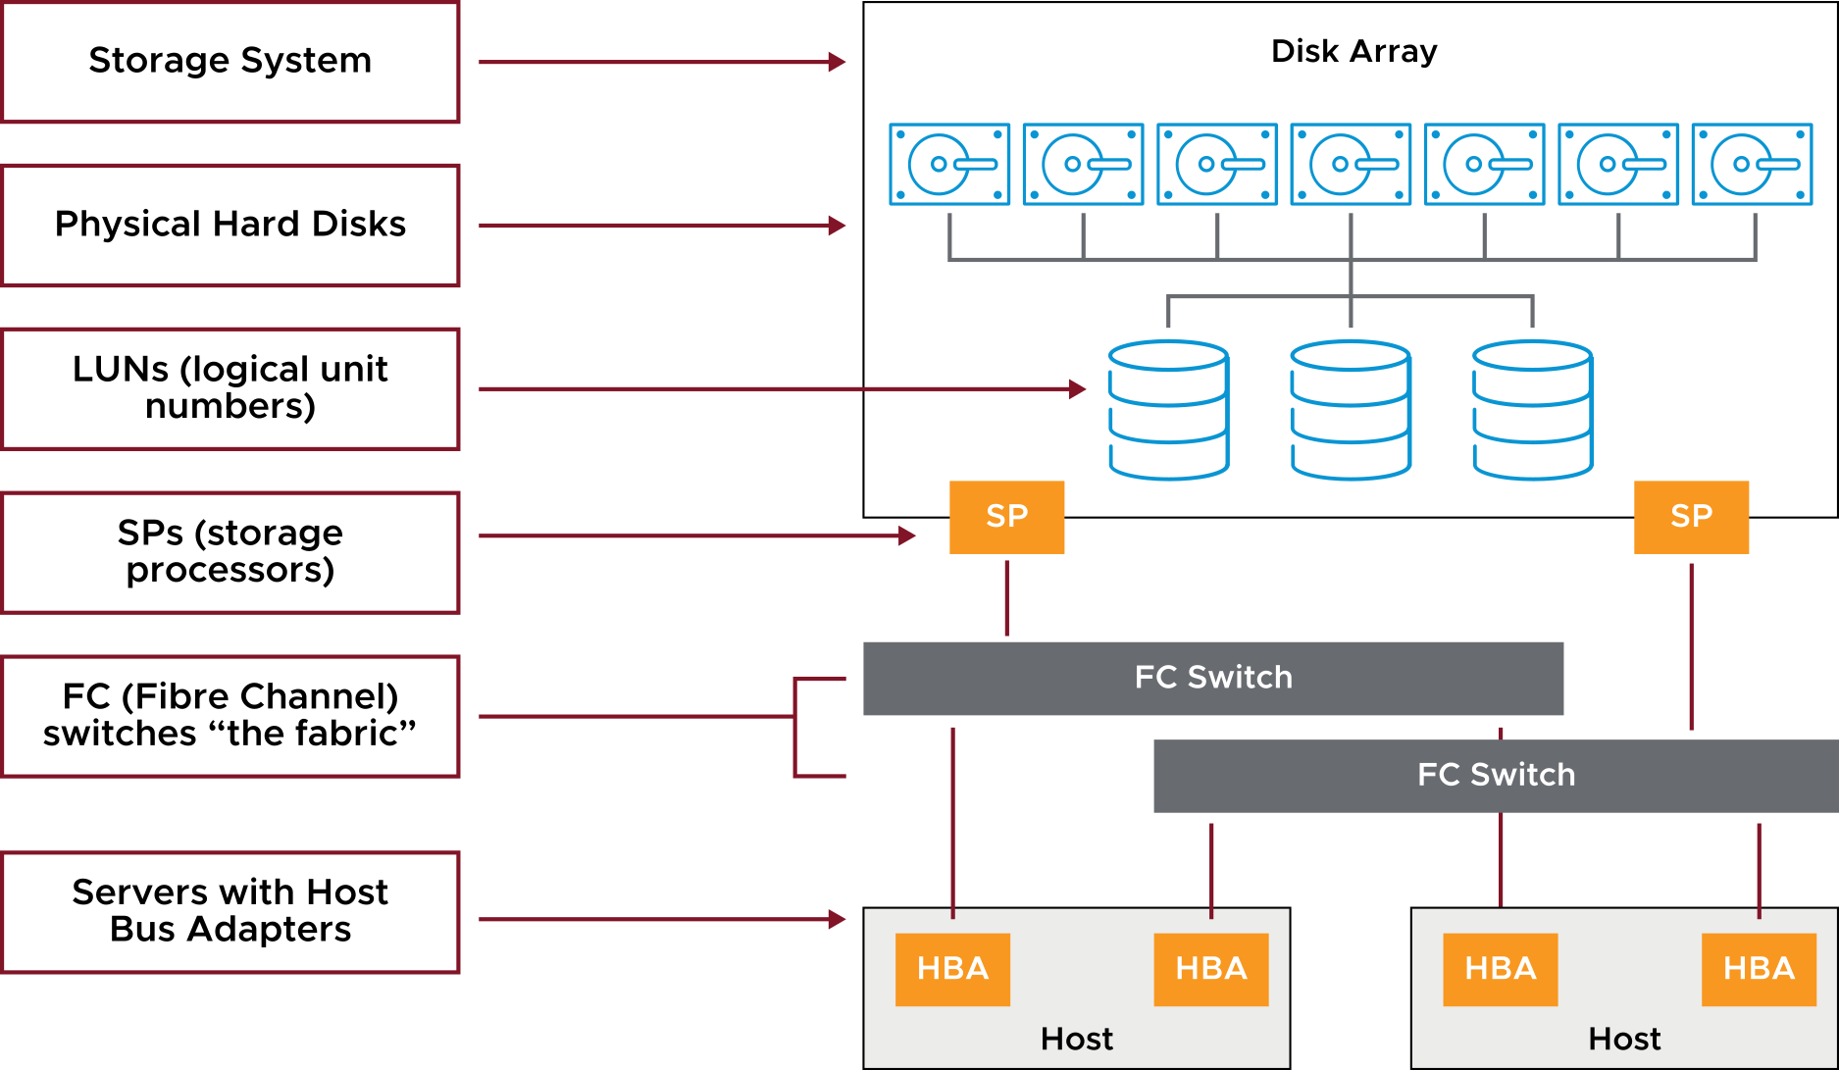
Fibre Channel SAN Components
A SAN consists of one or more servers that are attached to a storage array using one or more SAN switches.
Notes:
Each SAN server might host numerous applications that require dedicated storage for applications processing.
The following components are involved:
SAN switches: SAN switches connect various elements of the SAN. SAN switches might connect hosts to storage arrays. Using SAN switches, you can set up path redundancy to address any path failures from host server to switch, or from storage array to switch.
Fabric: The SAN fabric is the network portion of the SAN. When one or more SAN switches are connected, a fabric is created. The Fibre Channel (FC) protocol is used to communicate over the entire network. A SAN can consist of multiple interconnected fabrics. Even a simple SAN often consists of two fabrics for redundancy.
Connections (HBAs and storage processors): Host servers and storage systems are connected to the SAN fabric through ports in the fabric:
A host connects to a fabric port through an HBA.
Storage devices connect to the fabric ports through their storage processors.

Slide 21
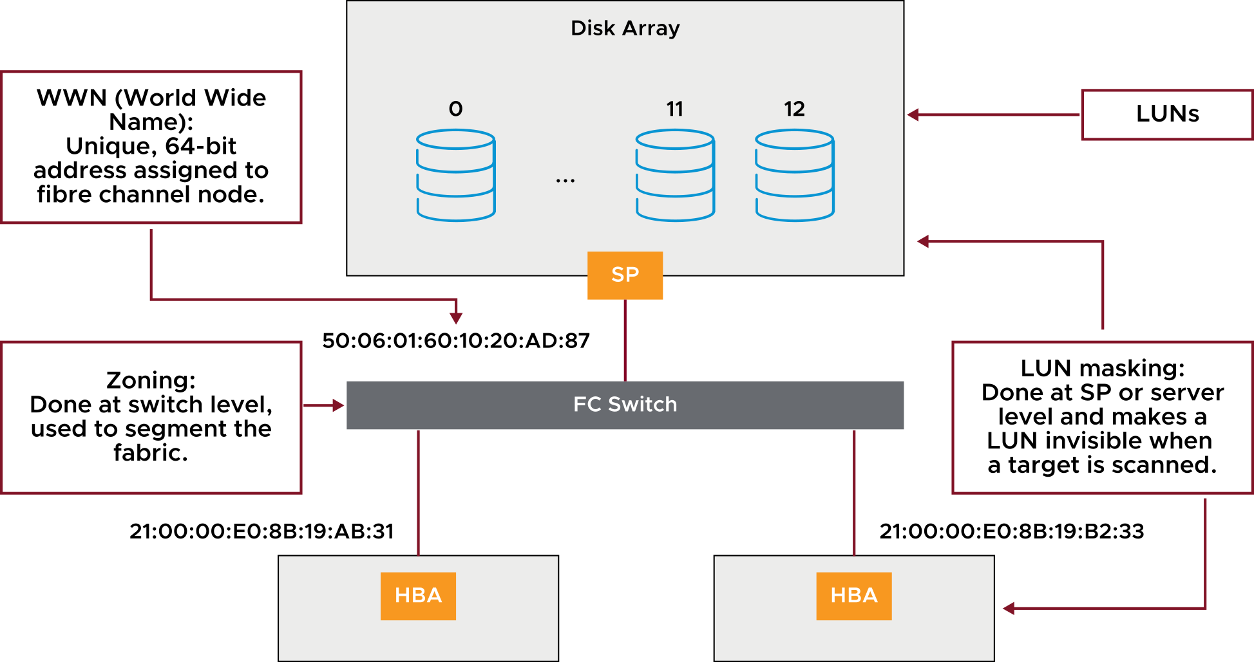
Fibre Channel Addressing and Access Control
Notes:
A port connects from a device into the SAN. Each node in the SAN includes each host, storage device, and fabric component (router or switch). Each node in the SAN has one or more ports that connect it to the SAN. Ports can be identified in the following ways:
World Wide Port Name (WWPN): A globally unique identifier for a port that allows certain applications to access the port. The Fibre Channel switches discover the WWPN of a device or host and assign a port address to the device.
Port_ID: Within SAN, each port has a unique port ID that serves as the Fibre Channel address for that port. The Fibre Channel switches assign the port ID when the device logs in to the fabric. The port ID is valid only while the device is logged on.
You can use zoning and LUN masking to segregate SAN activity and restrict access to storage devices.
You can protect access to storage in your vSphere environment by using zoning and LUN masking with your SAN resources. For example, you might manage zones defined for testing independently within the SAN so that they do not interfere with activity in the production zones. Similarly, you might set up different zones for different departments.
When you set up zones, consider host groups that are set up on the SAN device.
Zoning and masking capabilities for each SAN switch and disk array, and the tools for managing LUN masking, are vendor-specific.
See your SAN vendor’s documentation and vSphere Storage at https://docs.vmware.com/en/VMware-vSphere/7.0/com.vmware.vsphere.storage.doc/GUID-8AE88758-20C1-4873-99C7-181EF9ACFA70.html.

Slide 22
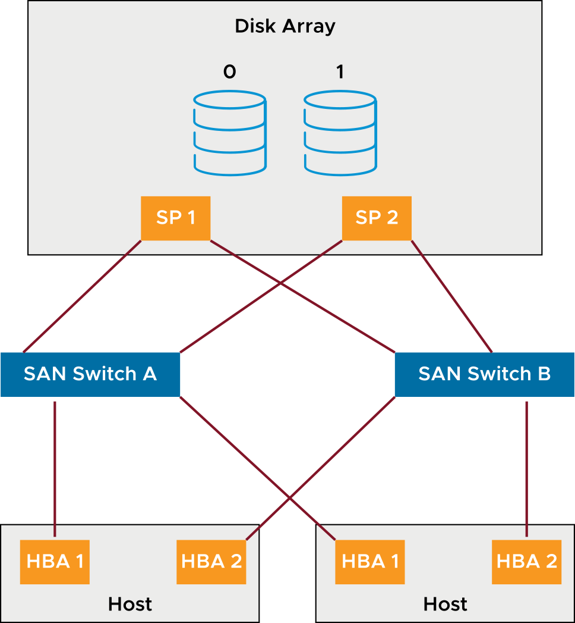
Multipathing with Fibre Channel
Multipathing is having more than one path from a host to a LUN. Multipathing provides the following functions:
Continued access to SAN LUNs if hardware fails
Load balancing
Notes:
A Fibre Channel path describes a route:
From a specific HBA port in the host
Through the switches in the fabric
Into a specific storage port on the storage array
By default, ESXi hosts use only one path from a host to a given LUN at any one time. If the path actively being used by the ESXi host fails, the server selects another available path. The process of detecting a failed path and switching to another is called path failover. A path fails if any of the components along the path (HBA, cable, switch port, or storage processor) fail.
Distinguishing between active-active and active-passive disk arrays can be useful:
An active-active disk array allows access to the LUNs simultaneously through the available storage processors without significant performance degradation. All the paths are active at all times (unless a path fails).
In an active-passive disk array, one storage processor is actively servicing a given LUN. The other storage processor acts as a backup for the LUN and might be actively servicing other LUN I/O.
I/O can be sent only to an active processor. If the primary storage processor fails, one of the secondary storage processors becomes active, either automatically or through administrative intervention.

Slide 23
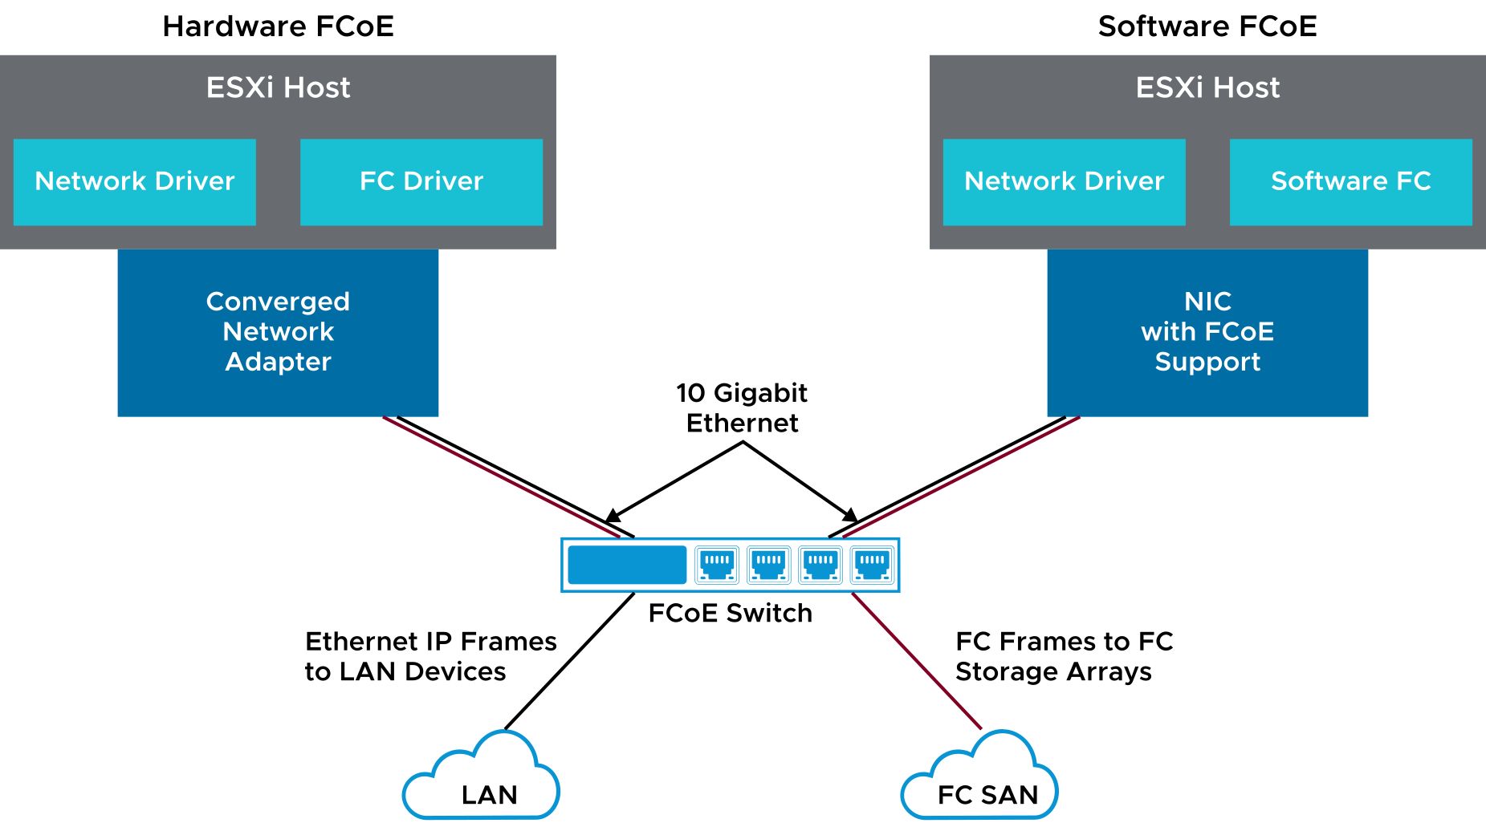
FCoE Adapters
If your host contains FCoE adapters, you can connect to your shared Fibre Channel devices by using an Ethernet network.
Notes:
The Fibre Channel traffic is encapsulated into FCoE frames. These FCoE frames are converged with other types of traffic on the Ethernet network. When both Ethernet and Fibre Channel traffic are carried on the same Ethernet link, use of the physical infrastructure increases. FCoE also reduces the total number of network ports and cabling.

Slide 24
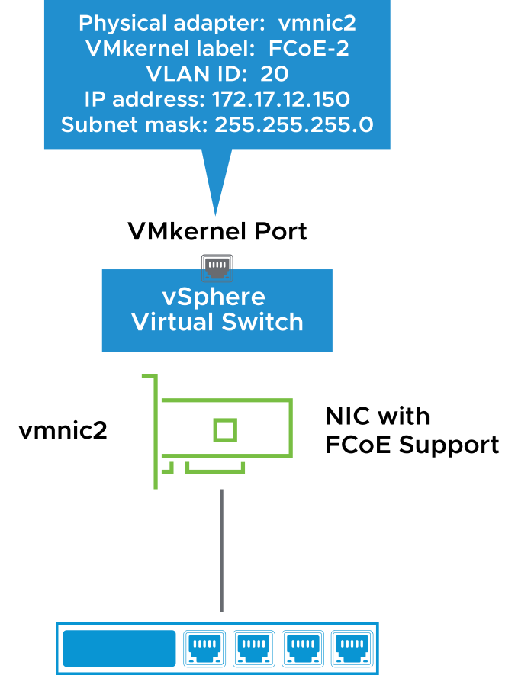
Configuring Software FCoE: Creating VMkernel Ports
Step 1: Connect the VMkernel to the physical FCoE NICs that are installed on your host:
The VLAN ID and the priority class are discovered during FCoE initialization. The priority class is not configured in vSphere.
ESXi supports a maximum of four network adapter ports for software FCoE.

Slide 25
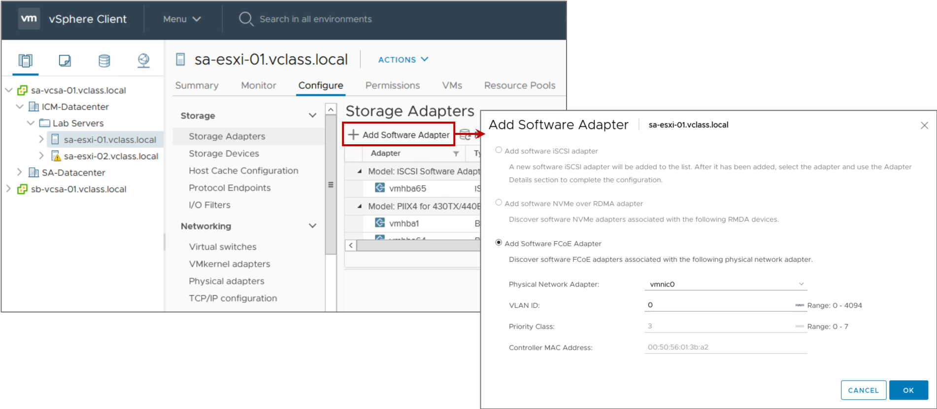
Configuring Software FCoE: Activating Software FCoE Adapters
Step 2: Add the software FCoE adapter and configure it as needed.
Notes:
You add the software FCoE adapter by selecting the host, clicking the Configure tab, selecting Storage Adapters, and clicking Add Software Adapter.

Slide 26
Review of Learner Objectives
After completing this lesson, you should be able to meet the following objectives:
Describe uses of Fibre Channel with ESXi
Identify Fibre Channel components and addressing
Explain how multipathing with Fibre Channel works

Slide 27
Lesson 3: iSCSI Storage

Slide 28
Learner Objectives
After completing this lesson, you should be able to meet the following objectives:
Identify uses of IP storage with ESXi
Describe iSCSI components and addressing
Configure iSCSI initiators
Recognize storage device naming conventions

Slide 29
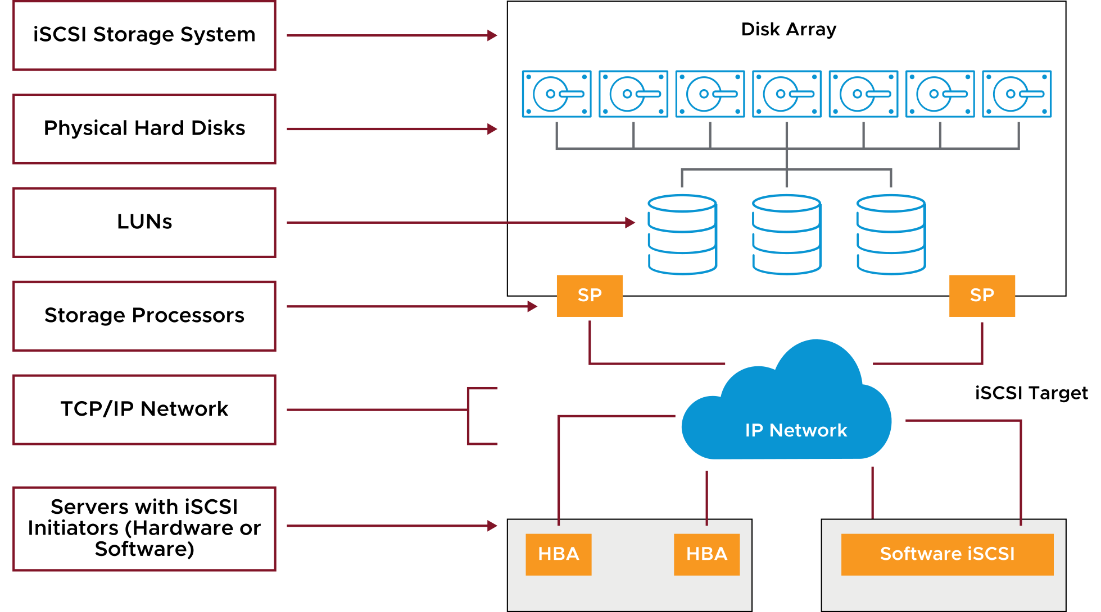
iSCSI Components
An iSCSI SAN consists of an iSCSI storage system, which contains LUNs and storage processors. Communication between the host and storage array occurs over a TCP/IP network.
Notes:
An iSCSI SAN consists of an iSCSI storage system, which contains one or more LUNs and one or more storage processors. Communication between the host and the storage array occurs over a TCP/IP network.
The ESXi host is configured with an iSCSI initiator. An initiator can be hardware-based, where the initiator is an iSCSI HBA. Or the initiator can be software-based, known as the iSCSI software initiator.
An initiator transmits SCSI commands over the IP network. A target receives SCSI commands from the IP network. Your iSCSI network can include multiple initiators and targets. iSCSI is SAN-oriented for the following reasons:
The initiator finds one or more targets.
A target presents LUNs to the initiator.
The initiator sends SCSI commands to a target.
An initiator resides in the ESXi host. Targets reside in the storage arrays that are supported by the ESXi host.
To restrict access to targets from hosts, iSCSI arrays can use various mechanisms, including IP address, subnets, and authentication requirements.

Slide 30
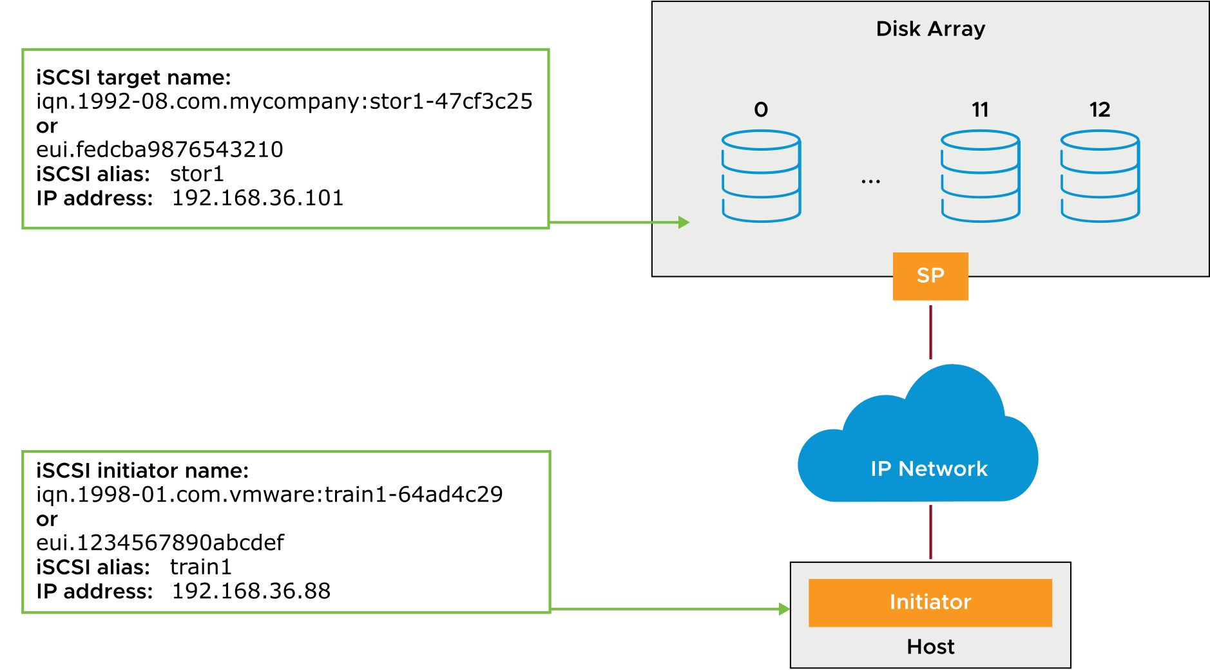
iSCSI Addressing
Notes:
The main addressable, discoverable entity is an iSCSI node. An iSCSI node can be an initiator or a target. An iSCSI node requires a name so that storage can be managed regardless of address.
The iSCSI name can use one of the following formats: The iSCSI qualified name (IQN) or the extended unique identifier (EUI).
The IQN can be up to 255 characters long. Several naming conventions are used:
Prefix iqn
Date code specifying the year and month in which the organization registered the domain or subdomain name that is used as the naming authority string
Organizational naming authority string, which consists of a valid, reversed domain or subdomain name
(Optional) Colon (:), followed by a string of the assigning organization’s choosing, which must make each assigned iSCSI name unique
EUI naming conventions are as follows:
Prefix is eui.
A 16-character name follows the prefix.
The name includes 24 bits for a company name that is assigned by the IEEE and 40 bits for a unique ID, such as a serial number.

Slide 31
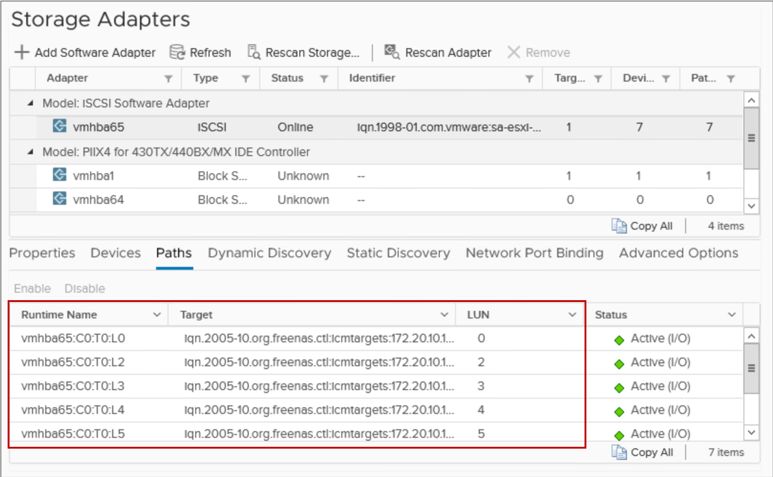
Storage Device Naming Conventions
Storage devices are identified in several ways:
Runtime name: Uses the vmhbaN:C:T:L convention. This name is not persistent through reboots.
Target: Identifies the iSCSI target address and port.
LUN: A unique identifier designated to individual or collections of hard disk devices. A logical unit is addressed by the SCSI protocol or SAN protocols that encapsulate SCSI, such as iSCSI or Fibre Channel.
Notes:
On ESXi hosts, SCSI storage devices use various identifiers. Each identifier serves a specific purpose. For example, the VMkernel requires an identifier, generated by the storage device, which is guaranteed to be unique to each LUN. If the storage device cannot provide a unique identifier, the VMkernel must generate a unique identifier to represent each LUN or disk.
The following SCSI storage device identifiers are available:
Runtime name: The name of the first path to the device. The runtime name is a user-friendly name that is created by the host after each reboot. It is not a reliable identifier for the disk device because it is not persistent. The runtime name might change if you add HBAs to the ESXi host. However, you can use this name when you use command-line utilities to interact with storage that an ESXi host recognizes.
iSCSI name: A worldwide unique name for identifying the node. iSCSI uses the IQN and EUI. IQN uses the format iqn.yyyy-mm.naming-authority:unique name.
Storage device names appear in various panels in the vSphere Client.

Slide 32
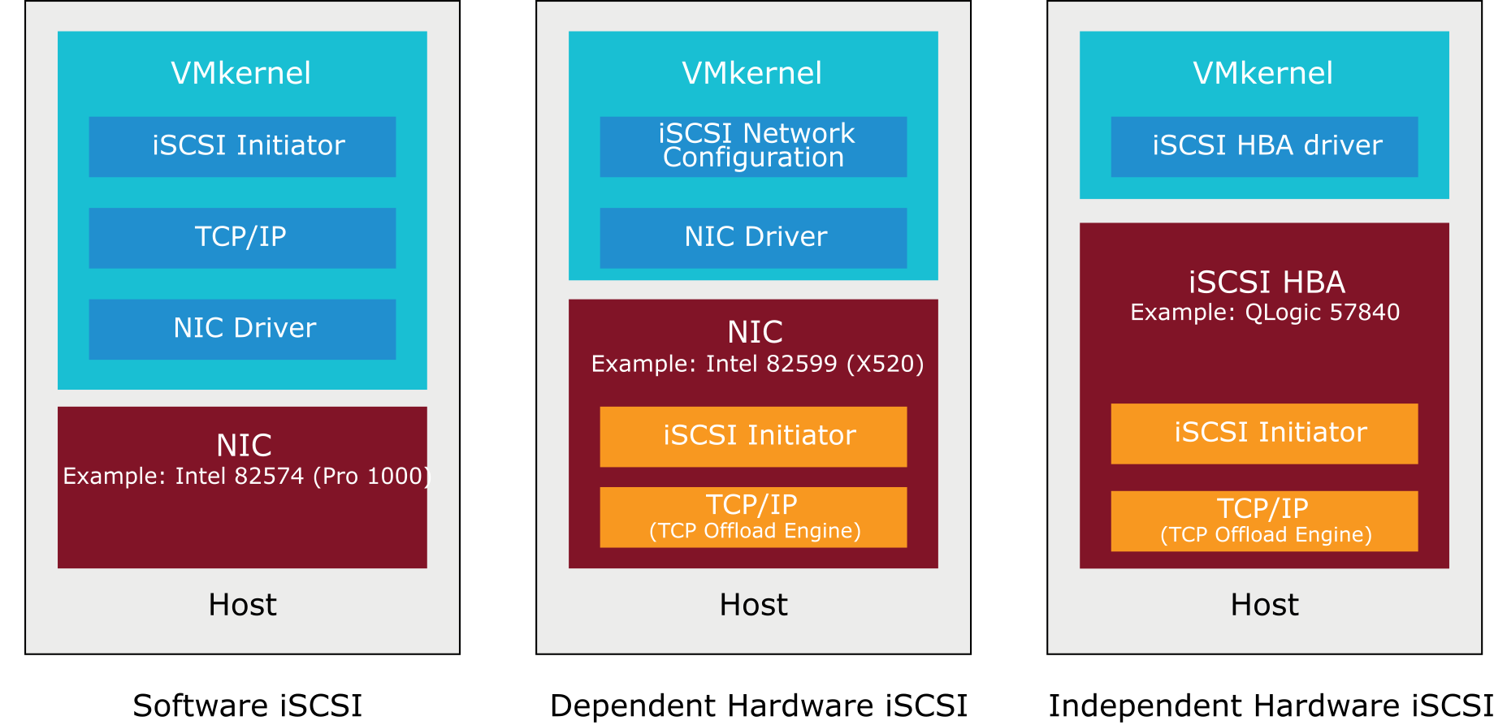
iSCSI Adapters
You must set up software or hardware iSCSI adapters before an ESXi host can work with iSCSI storage.
To access iSCSI targets, your host uses iSCSI initiators.
Notes:
The iSCSI initiators transport SCSI requests and responses, encapsulated in the iSCSI protocol, between the host and the iSCSI target. Your host supports two types of initiators: software iSCSI and hardware iSCSI.
A software iSCSI initiator is VMware code built in to the VMkernel. Using the initiator, your host can connect to the iSCSI storage device through standard network adapters. The software iSCSI initiator handles iSCSI processing while communicating with the network adapter. With the software iSCSI initiator, you can use iSCSI technology without purchasing specialized hardware.
A hardware iSCSI initiator is a specialized third-party adapter capable of accessing iSCSI storage over TCP/IP. Hardware iSCSI initiators are divided into two categories: dependent hardware iSCSI and independent hardware iSCSI.
A dependent hardware iSCSI initiator, also known as an iSCSI host bus adapter, is a standard network adapter that includes the iSCSI offload function. To use this type of adapter, you must configure networking for the iSCSI traffic and bind the adapter to an appropriate VMkernel iSCSI port.
An independent hardware iSCSI adapter handles all iSCSI and network processing and management for your ESXi host. In this case, a VMkernel iSCSI port is not required.
For configuration information, see vSphere Storage at https://docs.vmware.com/en/VMware-vSphere/7.0/com.vmware.vsphere.storage.doc/GUID-8AE88758-20C1-4873-99C7-181EF9ACFA70.html.

Slide 33
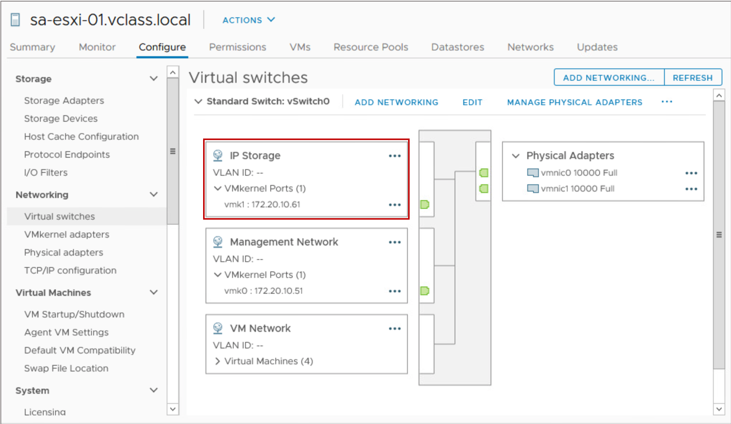
ESXi Network Configuration for IP Storage
A VMkernel port must be created for ESXi to access software iSCSI. The same port can be used to access NAS and NFS storage.
To optimize your vSphere networking setup, separate iSCSI networks from NAS and NFS networks:
Physical separation is preferred.
If physical separation is not possible, use VLANs.
Notes:
Networking configuration for software iSCSI involves creating a VMkernel port on a virtual switch to handle your iSCSI traffic.
Depending on the number of physical adapters that you want to use for the iSCSI traffic, the networking setup can be different:
If you have one physical network adapter, you need a VMkernel port on a virtual switch.
If you have two or more physical network adapters for iSCSI, you can use these adapters for host-based multipathing.
For performance and security, isolate your iSCSI network from other networks. Physically separate the networks. If physically separating the networks is impossible, logically separate the networks from one another on a single virtual switch by configuring a separate VLAN for each network.

Slide 34
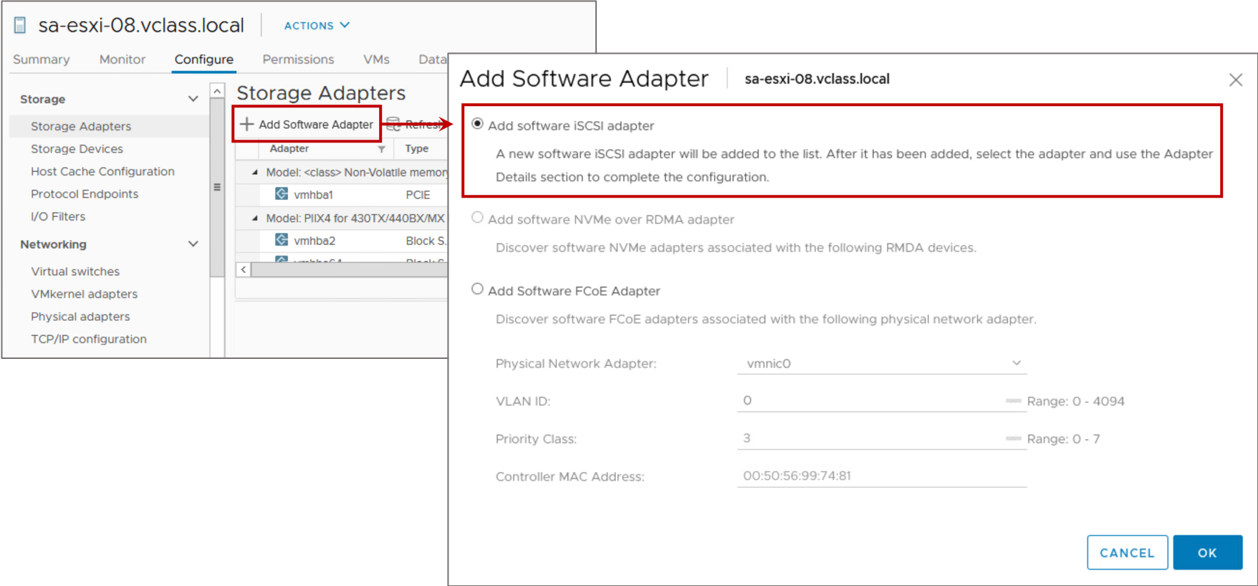
Activating the Software iSCSI Adapter
To add the software iSCSI adapter:
Select the host and click the Configure tab.
Select Storage Adapters and click Add Software Adapter.
Notes:
You must activate your software iSCSI adapter so that your host can use it to access iSCSI storage.
You can activate only one software iSCSI adapter.
NOTE If you boot from iSCSI using the software iSCSI adapter, the adapter is enabled, and the network configuration is created at the first boot. If you disable the adapter, it is reenabled each time you boot the host.

Slide 35
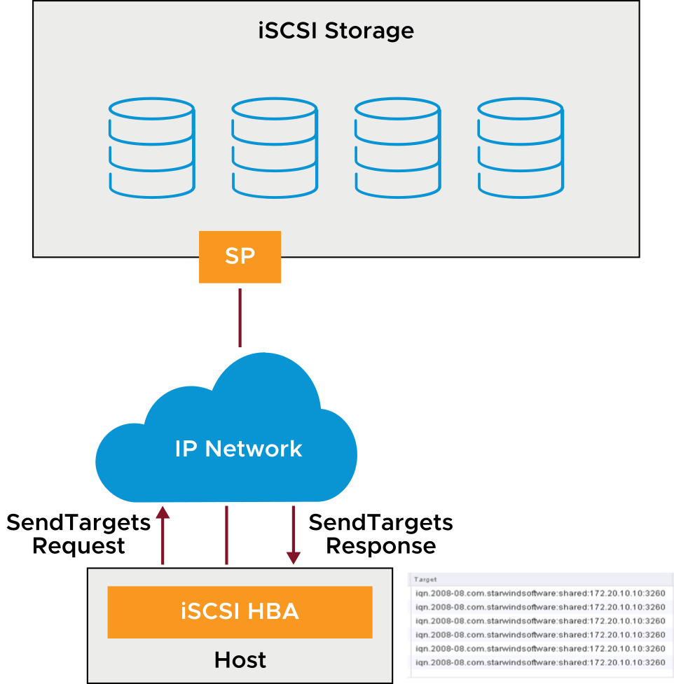
Discovering iSCSI Targets
The iSCSI adapter discovers storage resources on the network and determines which resources are available for access.
An ESXi host supports the following discovery methods:
Static
Dynamic or SendTargets
The SendTargets response returns the IQN and all available IP addresses.
Notes:
The ESXi host supports the following iSCSI target-discovery methods:
Static discovery: The initiator does not have to perform discovery. The initiator knows in advance all the targets that it will contact. It uses their IP addresses and domain names to communicate with them.
Dynamic discovery or SendTargets discovery: Each time the initiator contacts a specified iSCSI server, it sends the SendTargets request to the server. The server responds by supplying a list of available targets to the initiator.
The names and IP addresses of these targets appear as static targets in the vSphere Client. You can remove a static target that is added by dynamic discovery. If you remove the target, the target might be returned to the list during the next rescan operation. The target might also be returned to the list if the HBA is reset or the host is rebooted.

Slide 36
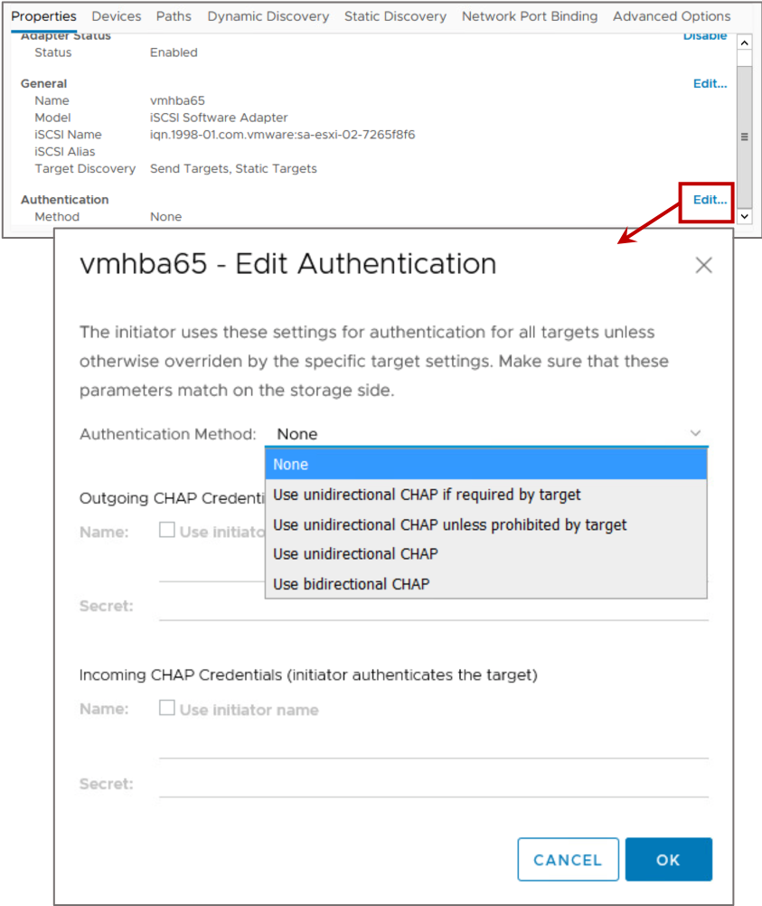
iSCSI Security: CHAP
iSCSI initiators use CHAP for authentication purposes.
By default, CHAP is not configured.
ESXi supports two types of CHAP authentication:
Unidirectional
Bidirectional
ESXi also supports per-target CHAP authentication.
Notes:
You can implement CHAP to provide authentication between iSCSI initiators and targets.
ESXi supports the following CHAP authentication methods:
Unidirectional or one-way CHAP: The target authenticates the initiator, but the initiator does not authenticate the target. You must specify the CHAP secret so that your initiators can access the target.
Bidirectional or mutual CHAP: With an extra level of security, the initiator can authenticate the target. You must specify different target and initiator secrets.
CHAP uses a three-way handshake algorithm to verify the identity of your host and, if applicable, of the iSCSI target when the host and target establish a connection. The verification is based on a predefined private value, or CHAP secret, that the initiator and target share. ESXi implements CHAP as defined in RFC 1994.
ESXi supports CHAP authentication at the adapter level. All targets receive the same CHAP secret from the iSCSI initiator. For both software iSCSI and dependent hardware iSCSI initiators, ESXi also supports per-target CHAP authentication.
Before configuring CHAP, check whether CHAP is enabled at the iSCSI storage system and check the CHAP authentication method that the system supports. If CHAP is enabled, you must enable it for your initiators, verifying that the CHAP authentication credentials match the credentials on the iSCSI storage. Using CHAP in your iSCSI SAN implementation is recommended, but consult with your storage vendor to ensure that best practices are followed.
You can protect your data in additional ways. For example, you might protect your iSCSI SAN by giving it a dedicated standard switch. You might also configure the iSCSI SAN on its own VLAN to improve performance and security. Some inline network devices might be implemented to provide encryption and further data protection.

Slide 37
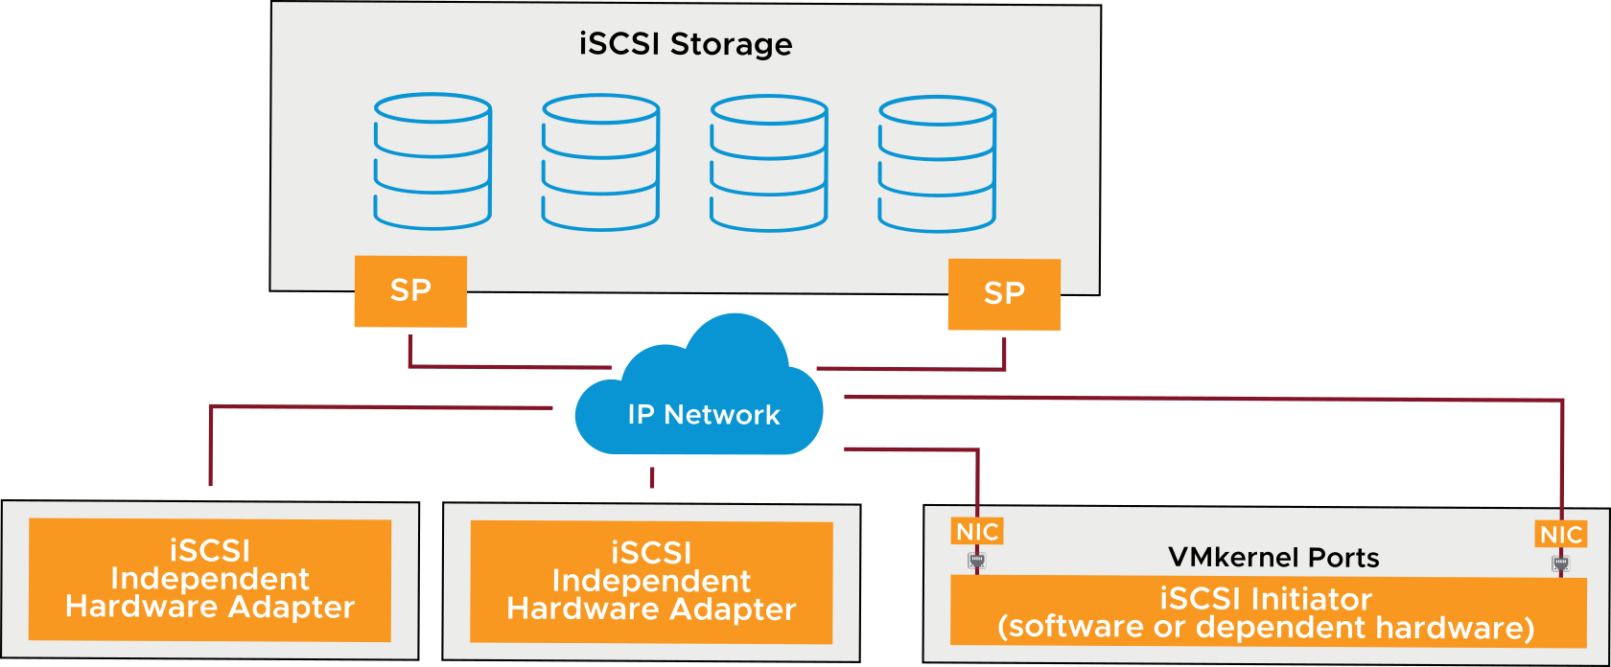
Multipathing with iSCSI Storage
Software or dependent hardware iSCSI uses multiple NICs:
Each NIC is connected to a separate VMkernel port.
Each VMkernel port binds with the iSCSI initiator.
Independent hardware iSCSI uses two or more hardware iSCSI adapters.
Notes:
When setting up your ESXi host for multipathing and failover, you can use multiple hardware iSCSI adapters or multiple NICs. The choice depends on the type of iSCSI initiators on your host.
With software iSCSI and dependent hardware iSCSI, you can use multiple NICs that provide failover for iSCSI connections between your host and iSCSI storage systems.
With independent hardware iSCSI, the host typically has two or more available hardware iSCSI adapters, from which the storage system can be reached by using one or more switches. Alternatively, the setup might include one adapter and two storage processors so that the adapter can use a different path to reach the storage system.
After iSCSI multipathing is set up, each port on the ESXi system has its own IP address, but the ports share the same iSCSI initiator IQN. When iSCSI multipathing is configured, the VMkernel routing table is not consulted for identifying the outbound NIC to use. Instead, iSCSI multipathing is managed using vSphere multipathing modules. Because of the latency that can be incurred, routing iSCSI traffic is not recommended.

Slide 38
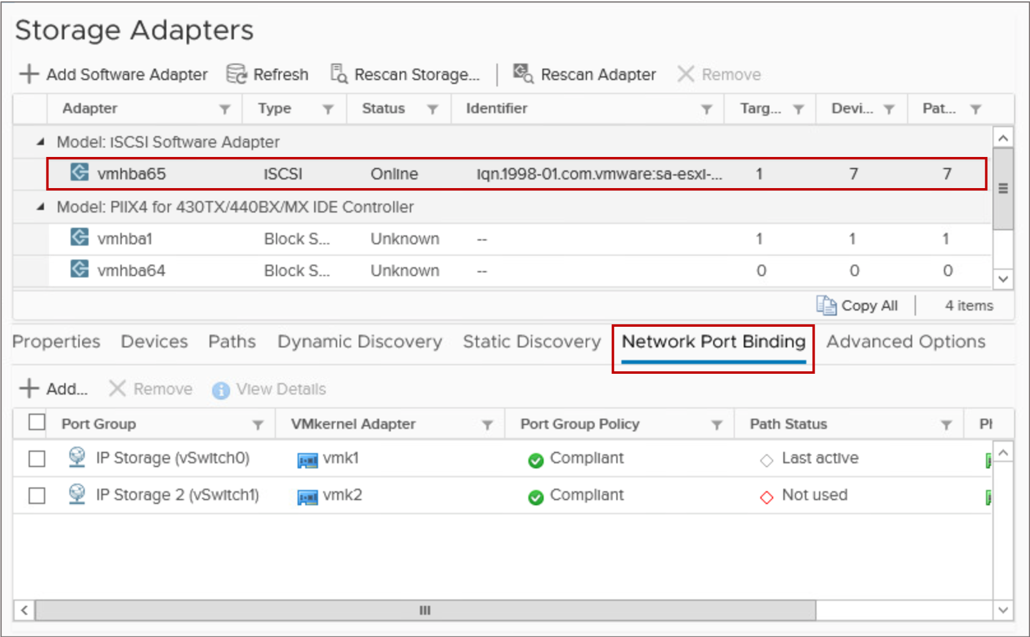
Binding VMkernel Ports with the iSCSI Initiator
With port binding, each VMkernel port that is connected to a separate NIC becomes a different path that the iSCSI storage stack can use.
Notes:
With software iSCSI and dependent hardware iSCSI, multipathing plug-ins do not have direct access to physical NICs on your host. For this reason, you must first connect each physical NIC to a separate VMkernel port. Then you use a port-binding technique to associate all VMkernel ports with the iSCSI initiator.
For dependent hardware iSCSI, you must correctly install the physical network card, which should appear on the host's Configure tab in the Virtual Switches view.

Slide 39
Lab 12: Accessing iSCSI Storage
Configure access to an iSCSI datastore:
View an Existing ESXi Host iSCSI Configuration
Add a VMkernel Port Group to a Standard Switch
Add the iSCSI Software Adapter to an ESXi Host
Connect the iSCSI Software Adapters to Storage

Slide 40
Review of Learner Objectives
After completing this lesson, you should be able to meet the following objectives:
Identify uses of IP storage with ESXi
Describe iSCSI components and addressing
Configure iSCSI initiators
Recognize storage device naming conventions

Slide 41
Lesson 4: VMFS Datastores

Slide 42
Learner Objectives
After completing this lesson, you should be able to meet the following objectives:
Create a VMFS datastore
Increase the size of a VMFS datastore
Delete a VMFS datastore

Slide 43
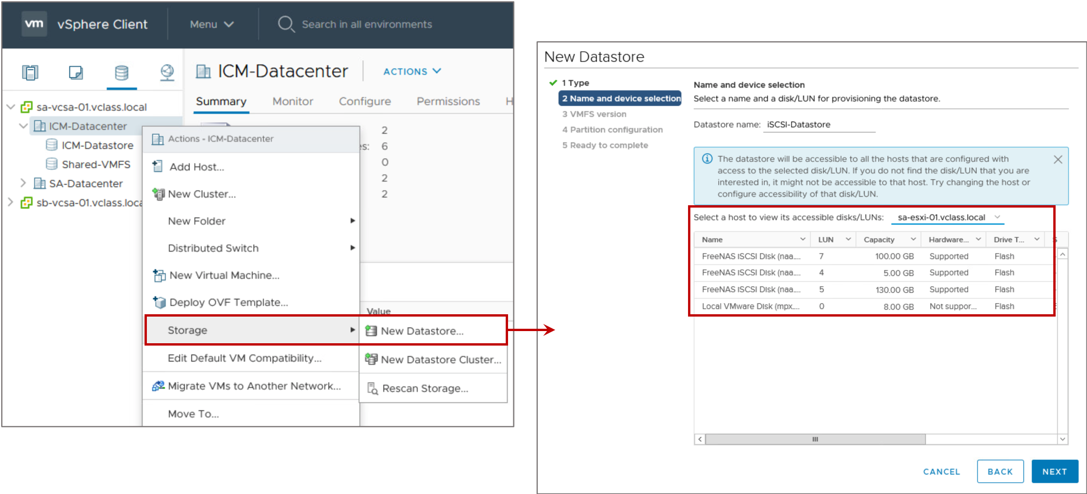
Creating a VMFS Datastore
You can create VMFS datastores on any SCSI-based storage devices that the host discovers, including Fibre Channel, iSCSI, and local storage devices.

Slide 44
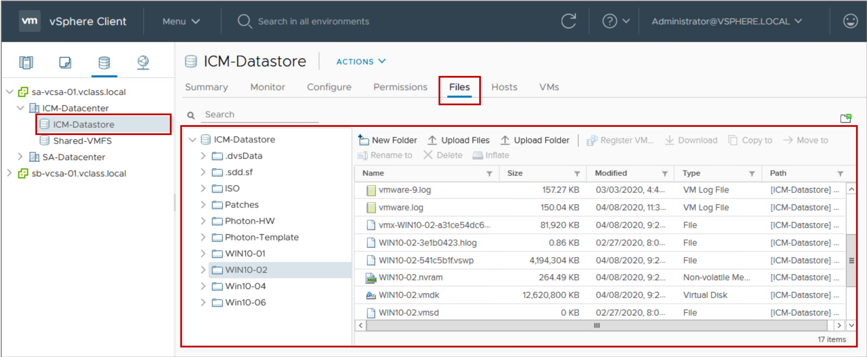
Browsing Datastore Contents
You use the datastore file browser to manage the contents of your datastores.
Notes:
The Datastores pane lists all datastores currently configured for all managed ESXi hosts.
The example shows the contents of the VMFS datastore named Class-Datastore. The contents of the datastore are folders that contain the files for virtual machines or templates.

Slide 45
About VMFS Datastores
A VMFS datastore primarily serves as a repository for VM files.
This type of datastore is optimized for storing and accessing large files, such as virtual disks and memory images of suspended VMs.
A VMFS datastore can have a maximum volume size of 64 TB.

Slide 46
Managing Overcommitted Datastores
A datastore becomes overcommitted when the total provisioned space of thin-provisioned disks is greater than the size of the datastore.
To actively monitor datastore capacity:
Set alarms to send notifications about:
Datastore disk overallocation
VM disk use
Use reporting to view space usage.
To actively manage datastore capacity:
Increase datastore capacity when necessary.
Use vSphere Storage vMotion to mitigate space use problems on a particular datastore.
Notes:
Using thin-provisioned virtual disks for your VMs is a way to make the most of your datastore capacity. But if your datastore is not sized properly, it can become overcommitted. A datastore becomes overcommitted when the full capacity of its thin-provisioned virtual disks is greater than the datastore’s capacity.
When a datastore reaches capacity, the vSphere Client prompts you to provide more space on the underlying VMFS datastore and all VM I/O is paused. Monitor your datastore capacity by setting alarms to alert you about how much a datastore’s disks are fully allocated or how much disk space a VM is using.
Manage your datastore capacity by dynamically increasing the size of your datastore when necessary. You can also use vSphere Storage vMotion to mitigate space use issues. For example, with vSphere Storage vMotion, you can migrate a VM off a datastore. The migration can be done by changing from virtual disks of thick format to thin format at the target datastore.

Slide 47
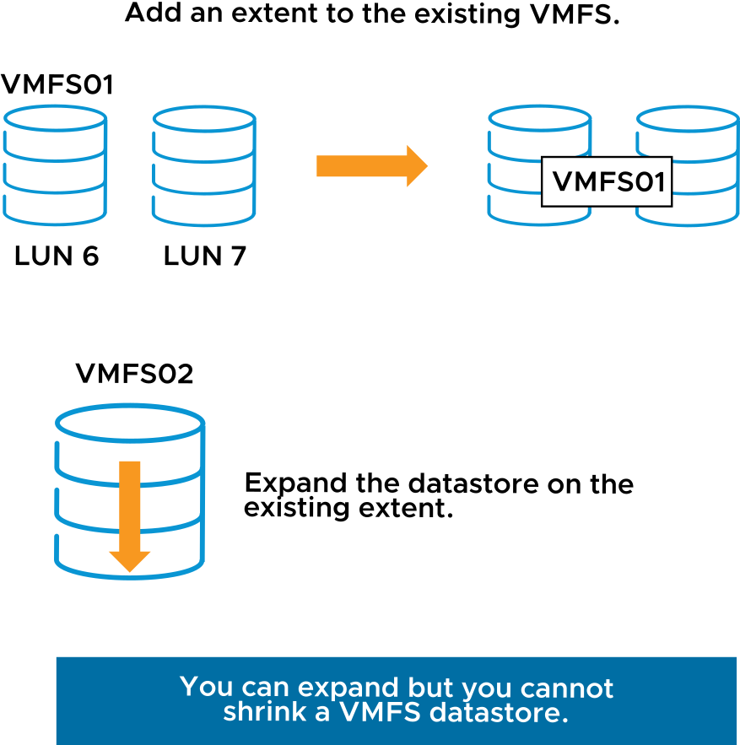
Increasing the Size of VMFS Datastores
Increase a VMFS datastore’s size to give it more space or to possibly improve performance.
In general, before changing your storage allocation:
Perform a rescan to ensure that all hosts see the most current storage.
Record the unique identifier of the volume that you want to expand.
To dynamically increase the size of a VMFS datastore:
Add an extent (LUN).
Expand the datastore within its extent.
Notes:
An example of the unique identifier of a volume is the NAA ID. You require this information to identify the VMFS datastore that must be increased.
You can dynamically increase the capacity of a VMFS datastore if the datastore has insufficient disk space. You discover whether insufficient disk space is an issue when you create a VM or you try to add more disk space to a VM.
Use one of the following methods:
Add an extent to the VMFS datastore: An extent is a partition on a LUN. You can add an extent to any VMFS datastore. The datastore can stretch over multiple extents, up to 32.
Expand the VMFS datastore: You expand the size of the VMFS datastore by expanding its underlying extent first.

Slide 48
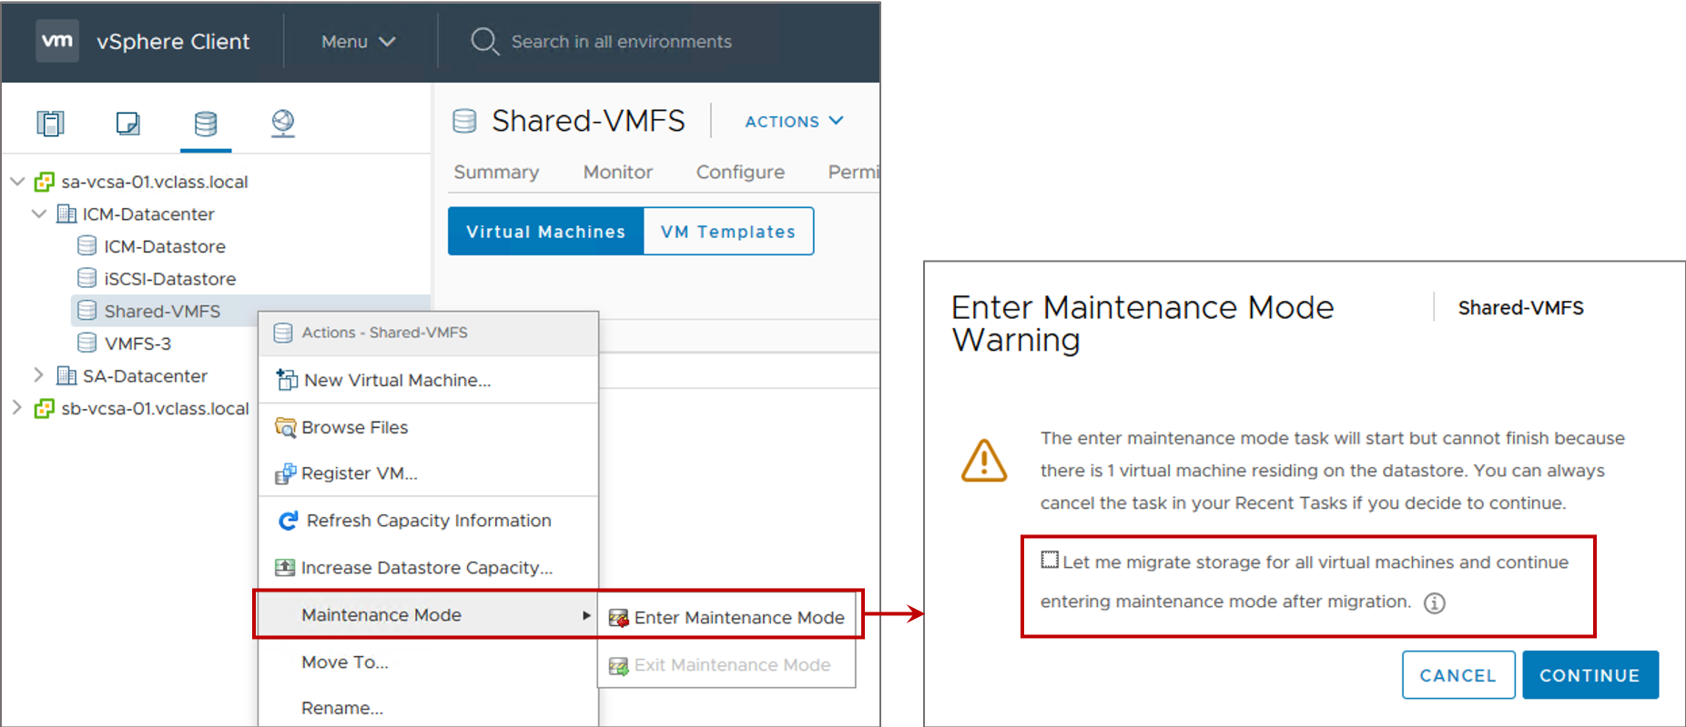
Datastore Maintenance Mode
Before taking a datastore out of service, place the datastore in maintenance mode.
Before placing a datastore in maintenance mode, you must migrate all VMs (powered on and powered off) and templates to a different datastore.
Notes:
By selecting the Let me migrate storage for all virtual machines and continue entering maintenance mode after migration check box, all VMs and templates on the datastore are automatically migrated to the datastore of your choice. The datastore enters maintenance mode after all VMs and templates are moved off the datastore.
Datastore maintenance mode is a function of the vSphere Storage DRS feature, but you can use maintenance mode without enabling vSphere Storage DRS. For more information on vSphere Storage DRS, see vSphere Resource Management at https://docs.vmware.com/en/VMware-vSphere/7.0/com.vmware.vsphere.resmgmt.doc/GUID-98BD5A8A-260A-494F-BAAE-74781F5C4B87.html.

Slide 49
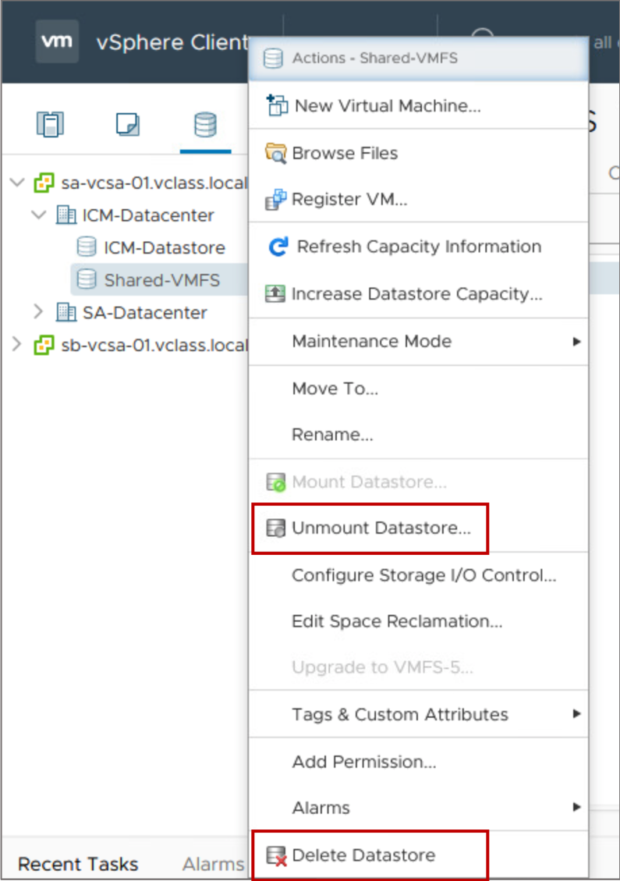
Deleting or Unmounting a VMFS Datastore
An unmounted datastore remains intact but cannot be seen from the hosts that you specify.
It continues to appear on other hosts, where it remains mounted.
A deleted datastore is destroyed and disappears from all hosts that have access to it.
The deleted datastore permanently removes all files on the datastore.
Notes:
Unmounting a VMFS datastore preserves the files on the datastore but makes the datastore inaccessible to the ESXi host. Do not perform any configuration operations that might result in I/O to the datastore while the unmounting is in progress.
You can delete any type of VMFS datastore, including copies that you mounted without resignaturing. Although you can delete the datastore without unmounting, you should unmount the datastore first. Deleting a VMFS datastore destroys the pointers to the files on the datastore, so the files disappear from all hosts that have access to the datastore.
Before you delete or unmount a VMFS datastore, power off all VMs whose disks reside on the datastore. If you do not power off the VMs and you try to continue, an error message tells you that the resource is busy. Before you unmount a VMFS datastore, use the vSphere Client to verify the following conditions:
No virtual machines reside on the datastore.
The datastore is not part of a datastore cluster.
The datastore is not managed by vSphere Storage DRS.
vSphere Storage I/O Control is disabled.
The datastore is not used for vSphere HA heartbeat.
To keep your data, back up the contents of your VMFS datastore before you delete the datastore.

Slide 50
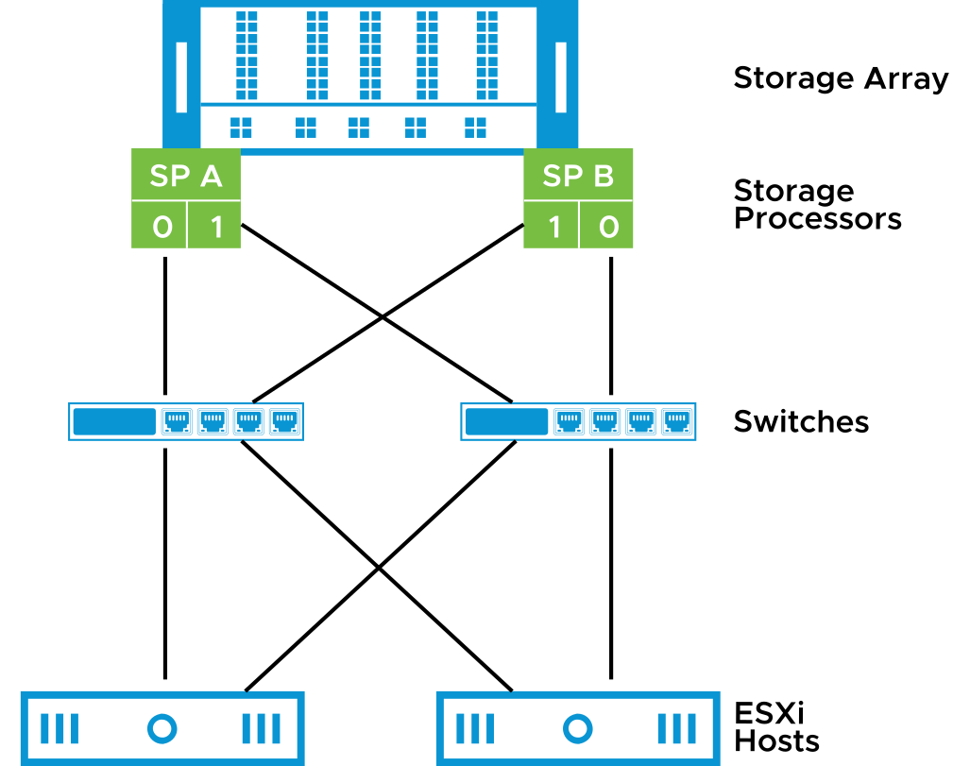
Multipathing Algorithms
Arrays provide active-active and active-passive storage processors. Multipathing algorithms interact with these storage arrays:
vSphere offers native path selection, load-balancing, and failover mechanisms.
Third-party vendors can create software for ESXi hosts to properly interact with the storage arrays.
Notes:
The Pluggable Storage Architecture is a VMkernel layer responsible for managing multiple storage paths and providing load balancing. An ESXi host can be attached to storage arrays with either active-active or active-passive storage processor configurations.
VMware offers native load-balancing and failover mechanisms. VMware path selection policies include the following examples:
Round Robin
Most Recently Used (MRU)
Fixed
Third-party vendors can design their own load-balancing techniques and failover mechanisms for particular storage array types to add support for new arrays. Third-party vendors do not need to provide internal information or intellectual property about the array to VMware.

Slide 51
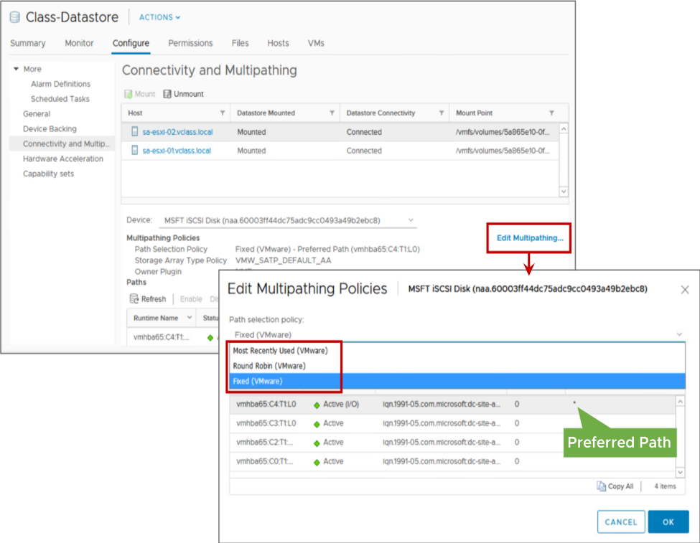
Configuring Storage Load Balancing
Path selection policies provide:
Scalability:
Round Robin
Availability:
Most Recently Used
Fixed
Notes:
Multiple paths from an ESXi host to a datastore are possible.
For multipathing with Fibre Channel or iSCSI, the following path selection policies are supported:
Fixed: The host always uses the preferred path to the disk when that path is available. If the host cannot access the disk through the preferred path, it tries the alternative paths. This policy is the default policy for active-active storage devices.
Most Recently Used: The host selects the first working path discovered at system boot time. When the path becomes unavailable, the host selects an alternative path. The host does not revert to the original path when that path becomes available. The Most Recently Used policy does not use the preferred path setting. This policy is the default policy for active-passive storage devices and is required for those devices.
Round Robin: The host uses a path selection algorithm that rotates through all available paths. In addition to path failover, the Round Robin multipathing policy supports load balancing across the paths. Before using this policy, check with storage vendors to find out whether a Round Robin configuration is supported on their storage.

Slide 52
Lab 13: Managing VMFS Datastores
Create and manage VMFS datastores:
Create VMFS Datastores for the ESXi Host
Expand a VMFS Datastore to Consume Unused Space on a LUN
Remove a VMFS Datastore
Extend a VMFS Datastore
Create a Second VMFS Datastore

Slide 53
Review of Learner Objectives
After completing this lesson, you should be able to meet the following objectives:
Create a VMFS datastore
Increase the size of a VMFS datastore
Delete a VMFS datastore

Slide 54
Lesson 5: NFS Datastores

Slide 55
Learner Objectives
After completing this lesson, you should be able to meet the following objectives:
Identify NFS components
Recognize the differences between NFS 3 and NFS 4.1
Configure and manage NFS datastores

Slide 56
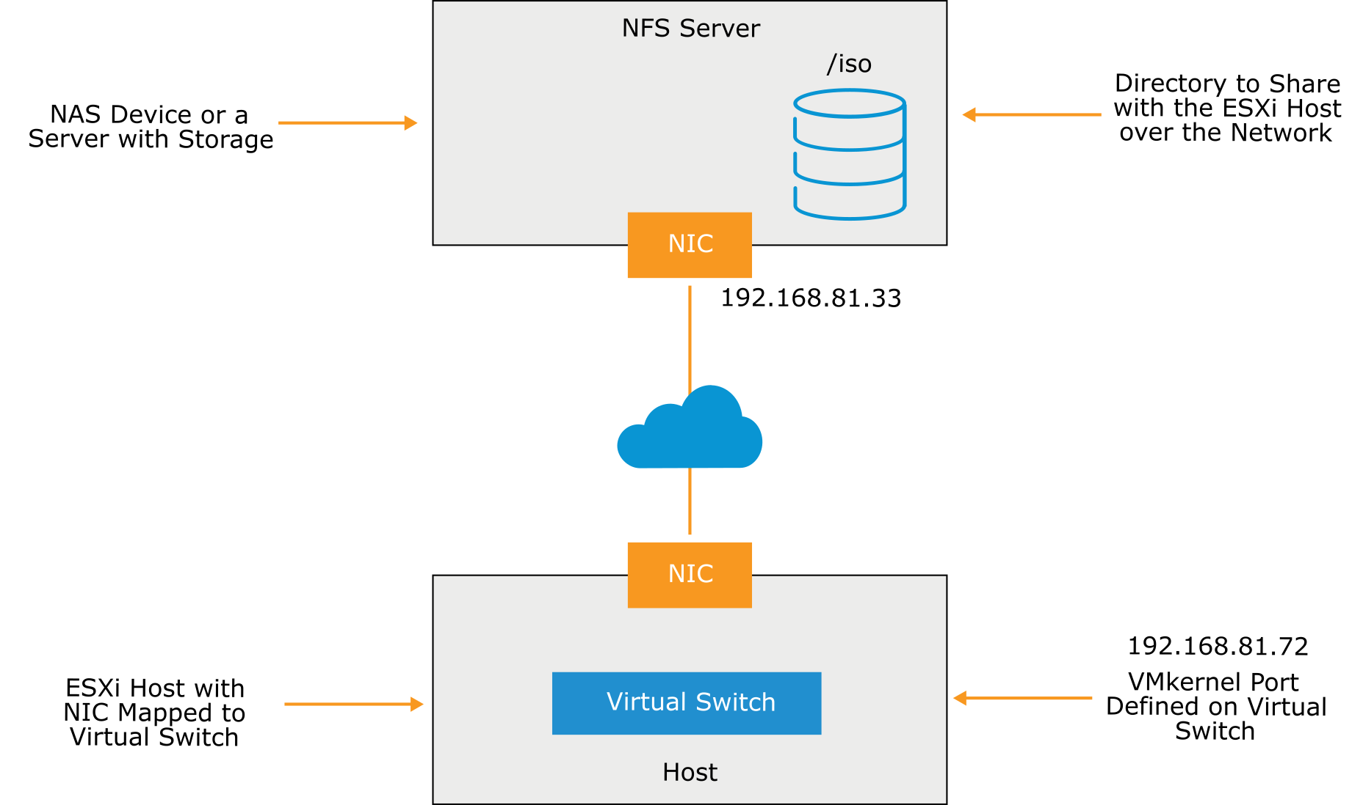
NFS Components
An NFS file system is on a NAS device that is called the NFS server.
Notes:
The NFS server contains one or more directories that are shared with the ESXi host over a TCP/IP network. An ESXi host accesses the NFS server through a VMkernel port that is defined on a virtual switch.

Slide 57
NFS v3 and NFS v4.1
An NFS datastore can be created as either NFS 3 or NFS 4.1.
NFS 3 | NFS 4.1
ESXi managed multipathing | Native multipathing and session trunking
AUTH_SYS (root) authentication | Optional Kerberos authentication
VMware proprietary client-side file locking | Server-side file locking
Client-side error tracking | Server-side error tracking
Notes:
Compatibility issues between the two NFS versions prevent access to datastores using both protocols at the same time from different hosts. If a datastore is configured as NFS 4.1, all hosts that access that datastore must mount the share as NFS 4.1. Data corruption can occur if hosts access a datastore with the wrong NFS version.

Slide 58
NFS Version Compatibility with Other vSphere Technologies
vSphere supports NFS 4.1 to overcome many limitations when using NFS 3. Both NFS 3 and NFS 4.1 shares can be used, but you must consider important constraints when designing a vSphere environment in which both versions are used.
vSphere Technology | NFS 3 | NFS 4.1
vSphere vMotion and vSphere Storage vMotion | Yes | Yes
vSphere HA and vSphere Fault Tolerance | Yes | Yes
vSphere DRS and vSphere DPM | Yes | Yes
Stateless ESXi and Host Profiles | Yes | Yes
vSphere Storage DRS and Storage I/O Control | Yes | No
Site Recovery Manager | Yes | No
vSphere Virtual Volumes and vSphere Replication | Yes | Yes
vRealize Operations Manager | Yes | Yes
Host Profiles | Yes | Yes
Notes:
NFS 4.1 provides the following enhancements:
Native multipathing and session trunking: NFS 4.1 provides multipathing for servers that support session trunking. When trunking is available, you can use multiple IP addresses to access a single NFS volume. Client ID trunking is not supported.
Kerberos authentication: NFS 4.1 introduces Kerberos authentication in addition to the traditional AUTH_SYS method used by NFS 3.
Improved built-in file locking.
Enhanced error recovery using server-side tracking of open files and delegations.
Many general efficiency improvements including session leases and less protocol overhead.
The NFS 4.1 client offers the following new features:
Stateful locks with share reservation using a mandatory locking semantic
Protocol integration, side-band (auxiliary) protocol no longer required to lock and mount
Trunking (true NFS multipathing), where multiple paths (sessions) to the NAS array can be created and load-distributed across those sessions
Enhanced error recovery to mitigate server failure and loss of connectivity

Slide 59
Configuring NFS Datastores
To configure an NFS datastore:
Create a VMkernel port:
For better performance and security, separate your NFS network from the iSCSI network.
Create the NFS datastore by providing the following information:
NFS version: 3 or 4.1
Datastore name
NFS server names or IP addresses
Folder on the NFS server, for example, /templates or /nfs_share
Hosts that mount the datastore
Whether to mount the NFS file system as read only
Authentication parameters
Notes:
For each ESXi host that accesses an NFS datastore over the network, a VMkernel port must be configured on a virtual switch. The name of this port can be anything that you want. For performance and security reasons, isolate your NFS networks from the other networks, such as your iSCSI network and your virtual machine networks.

Slide 60
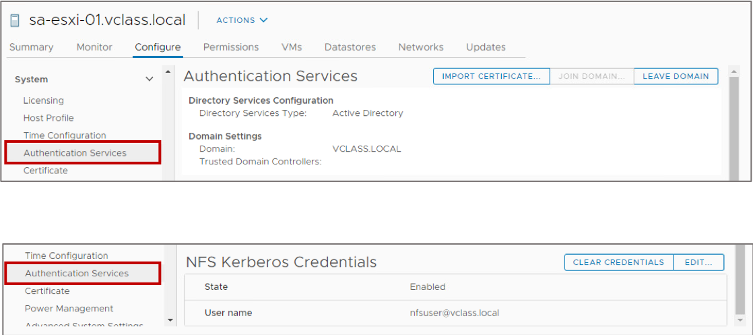
Configuring ESXi Host Authentication and NFS Kerberos Credentials
As a requirement of Kerberos authentication, you must add each ESXi host to the Active Directory domain. Then you configure NFS Kerberos credentials.
Notes:
You must take several configuration steps to prepare each ESXi host to use Kerberos authentication. Kerberos authentication requires that all nodes involved (the Active Directory server, the NFS servers, and the ESXi hosts) be synchronized so that little to no time drift exists. Kerberos authentication fails if any significant drift exists between the nodes. To prepare your ESXi host to use Kerberos authentication, configure the NTP client settings to reference a common NTP server (or the domain controller, if applicable).
When planning to use NFS Kerberos, consider the following points:
NFS 3 and 4.1 use different authentication credentials, resulting in incompatible UID and GID on files.
Using different Active Directory users on different hosts that access the same NFS share can cause the vSphere vMotion migration to fail.
NFS Kerberos configuration can be automated by using host profiles to reduce configuration conflicts.
Time must be synchronized between all participating components.

Slide 61
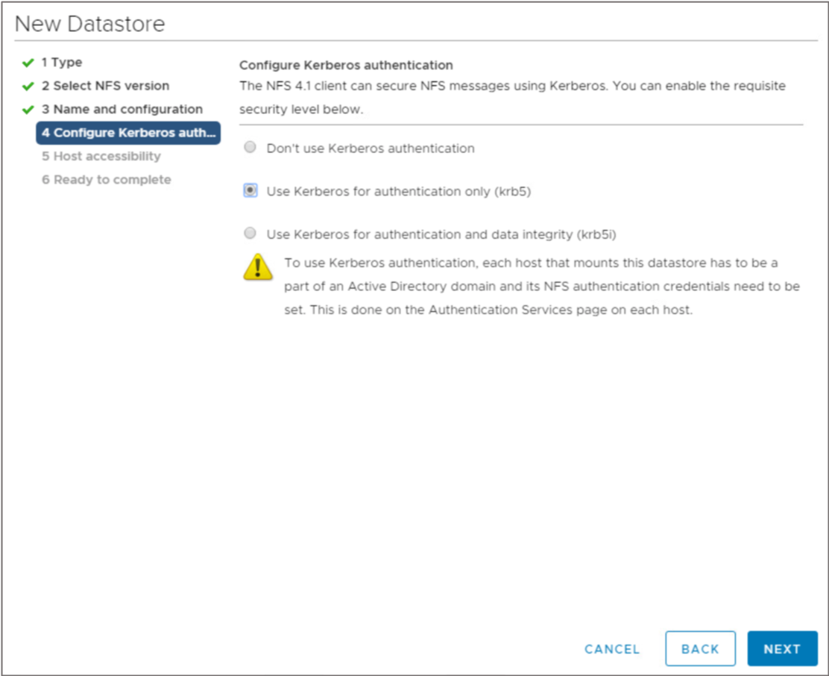
Configuring the NFS Datastore to Use Kerberos
When creating each NFS datastore, you enable Kerberos authentication by selecting one of the security modes:
Kerberos5 authentication
Kerberos5i authentication and data integrity
Notes:
After performing the initial configuration steps, you can configure the datastore to use Kerberos authentication.
The screenshot shows a choice of Kerberos authentication only (krb5) or authentication with data integrity (krb5i). The difference is whether only the header or the header and the body of each NFS operation is signed using a secure checksum.
For more information about how to configure the ESXi hosts for Kerberos authentication, see vSphere Storage at https://docs.vmware.com/en/VMware-vSphere/7.0/com.vmware.vsphere.storage.doc/GUID-8AE88758-20C1-4873-99C7-181EF9ACFA70.html.

Slide 62
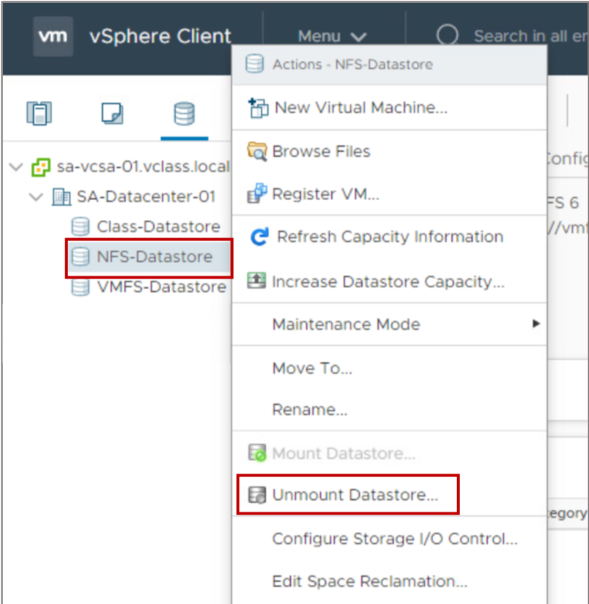
Unmounting an NFS Datastore
Unmounting an NFS datastore causes the files on the datastore to become inaccessible to the ESXi host.
Before unmounting an NFS datastore, you must stop all VMs whose disks reside on the datastore.

Slide 63
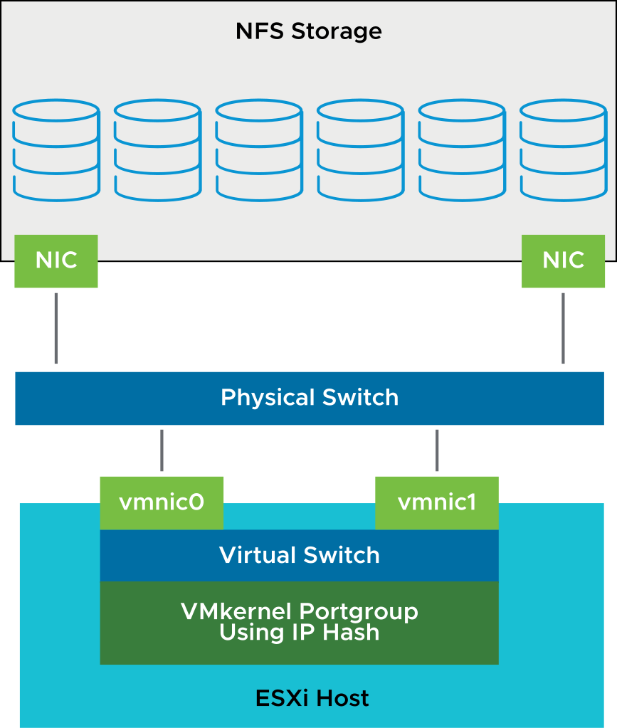
Multipathing and NFS Storage
For a highly available NAS architecture, configure NFS multipathing to avoid single points of failure.
Example of a multipathing configuration:
Configure one VMkernel port.
Attach NICs to the same physical switch to configure NIC teaming.
Configure the NFS server with multiple IP addresses (same subnet is OK).
To better use multiple links, configure NIC teams with the IP hash load-balancing policy.
Notes:
Examples of a single point of failure in the NAS architecture include the NIC card in an ESXi host, and the cable between the NIC card and the switch. To avoid single points of failure and to create a highly available NAS architecture, configure the ESXi host with redundant NIC cards and redundant physical switches.
The best approach is to install multiple NICs on an ESXi host and configure them in NIC teams. NIC teams should be configured on separate external switches, with each NIC pair configured as a team on the respective external switch. In addition, you might apply a load-balancing algorithm, based on the link aggregation protocol type supported on the external switch, such as 802.3ad or EtherChannel.
An even higher level of performance and high availability can be achieved with cross-stack, EtherChannel-capable switches. With certain network switches, you can team ports across two or more separate physical switches that are managed as one logical switch. NIC teaming across virtual switches provides additional resilience and some performance optimization. Having more paths available to the ESXi host can improve performance by enabling distributed load sharing.
Only one active path is available for the connection between the ESXi host and a single storage target (LUN or mount point). Although alternative connections might be available for failover, the bandwidth for a single datastore and the underlying storage is limited to what a single connection can provide. To use more available bandwidth, an ESXi host requires multiple connections from the ESXi host to the storage targets. You might need to configure multiple datastores, each using separate connections between the ESXi host and the storage.
The table shows the recommended configuration for NFS multipathing.

Slide 64
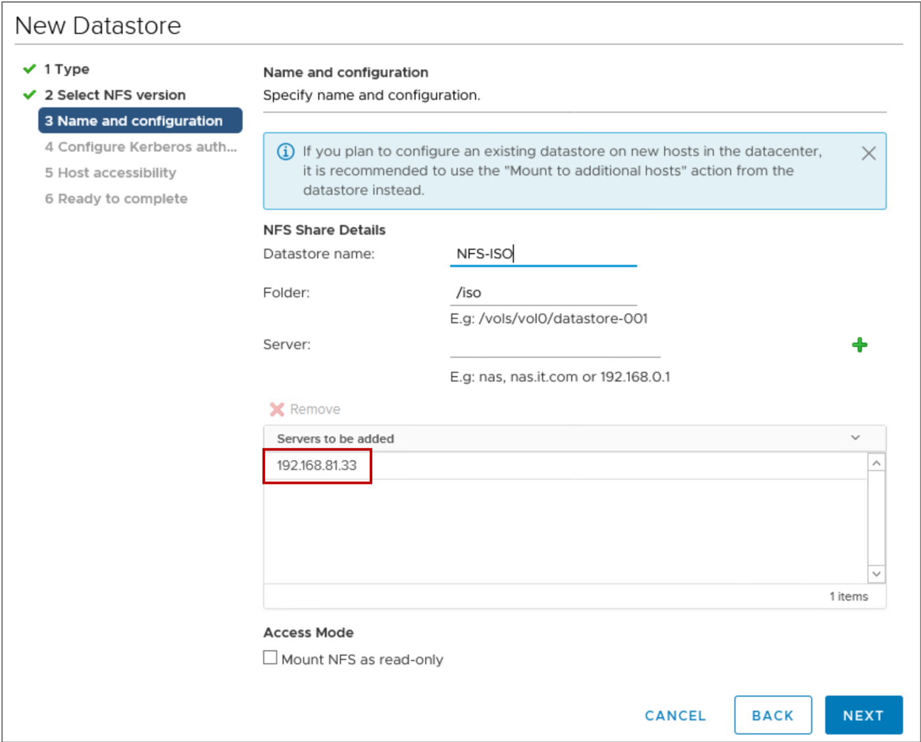
Enabling Multipathing for NFS 4.1
NFS 4.1 supports native multipathing and session trunking.
To enable multipathing, enter multiple server IP addresses when configuring the datastore.
Notes:
NFS 4.1 provides multipathing for servers that support the session trunking. When trunking is available, you can use multiple IP addresses to access a single NFS volume. Client ID trunking is not supported.

Slide 65
Lab 14: Accessing NFS Storage
Create an NFS datastore and record its storage information:
Configure Access to an NFS Datastore
View NFS Storage Information

Slide 66
Review of Learner Objectives
After completing this lesson, you should be able to meet the following objectives:
Identify NFS components
Recognize the differences between NFS 3 and NFS 4.1
Configure and manage NFS datastores

Slide 67
Lesson 6: vSAN Datastores

Slide 68
Learner Objectives
After completing this lesson, you should be able to meet the following objectives:
Explain the purpose of a vSAN datastore
Describe the architecture and requirements of vSAN configuration
Explain the purpose of vSAN storage policies

Slide 69
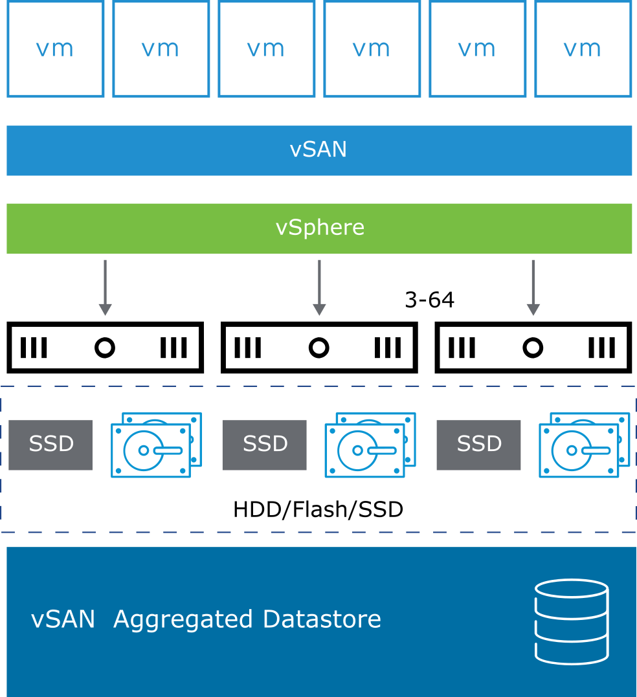
About vSAN Datastores
vSAN is a software-defined storage solution providing shared storage for vSphere clusters without using traditional external storage.
A vSAN cluster requires:
A minimum of three hosts to be part of the vSphere cluster and enabled for vSAN
A vSAN network
Local disks on each host that are pooled to create a virtual shared vSAN datastore
Notes:
vSAN datastores help administrators use software-defined storage in the following ways:
Storage policy per VM architecture: With multiple policies per datastore, each VM can have different storage.
vSphere and vCenter Server integration: vSAN capability is built in and requires no appliance. You create a vSAN cluster, like vSphere HA or vSphere DRS.
Scale-out storage: Up to 64 ESXi hosts can be in a cluster. Scale out by populating new nodes in the cluster.
Built-in resiliency: The default vSAN storage policy establishes RAID 1 redundancy for all VMs.

Slide 70
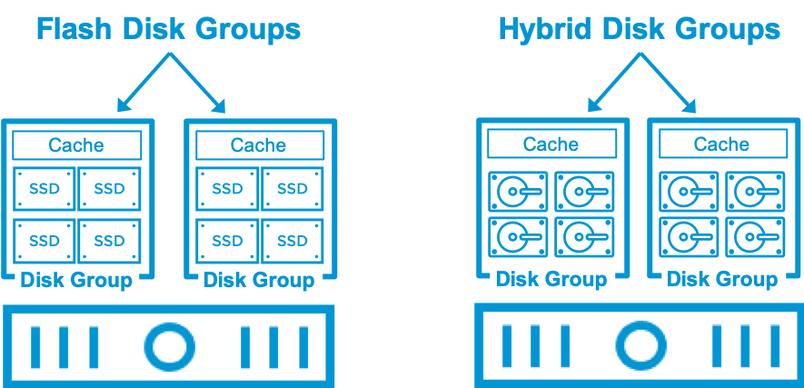
Disk Groups
Disk groups are vSAN management constructs on all ESXi hosts in a vSAN cluster. A host can include a maximum of five disk groups.
The disk groups are combined to create a single vSAN datastore. A disk group requires:
One flash device for caching
One to seven capacity devices for storage
Notes:
vSAN uses the concept of disk groups to pool together cache devices and capacity devices as single management constructs. A disk group is a pool of one cache device and one to seven capacity devices

Slide 71
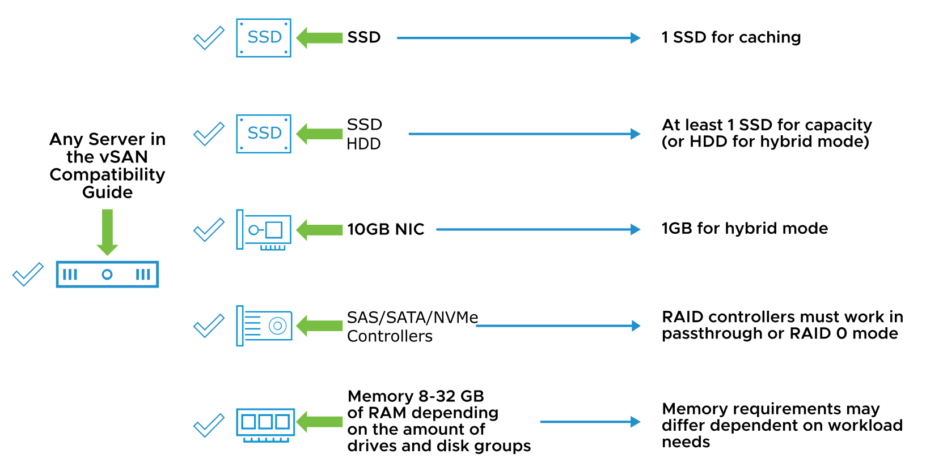
vSAN Hardware Requirements
vSAN capabilities are native to ESXi and require no additional software.
Notes:
vSAN requires several hardware components that hosts do not normally have:
One Serial Attached SCSI (SAS), SATA solid-state drive (SSD), or PCIe flash device and one to seven magnetic drives for each hybrid disk group.
One SAS, SATA SSD, or PCIe flash device and one to seven flash disks with flash capacity enabled for all-flash disk groups.
Dedicated 1 Gbps network (10 Gbps is recommended) for hybrid disk groups.
Dedicated 10 Gbps network for all-flash disk groups.
1 Gbps network speeds result in detrimental congestion for an all-flash architecture and are unsupported.
The vSAN network must be configured for IPv4 or IPv6 and support unicast.
In addition, each host should have a minimum of 32 GB of memory to accommodate a maximum number of five disk groups and a maximum number of seven capacity devices per disk group.

Slide 72
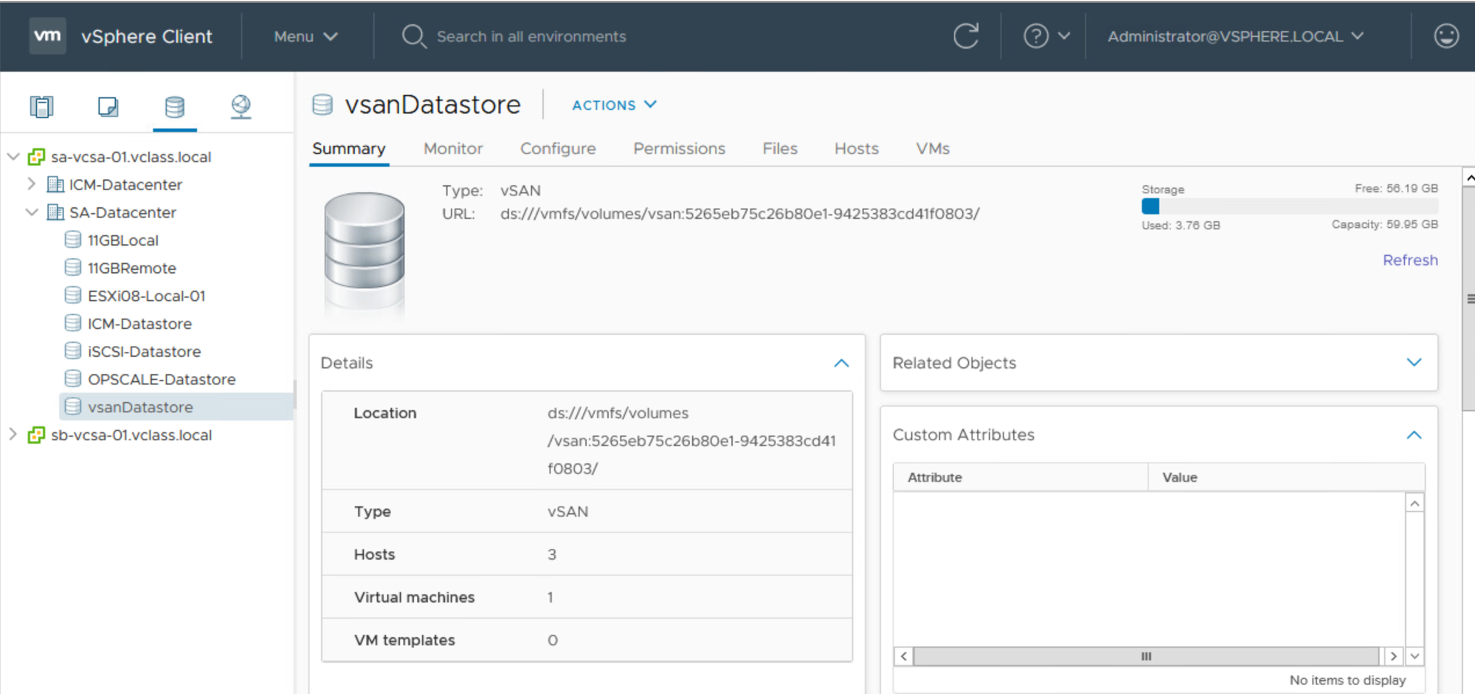
Viewing the vSAN Datastore Summary
The Summary tab of the vSAN datastore shows the general vSAN configuration information.

Slide 73
Objects in vSAN Datastores
vSAN storage is object-based and policy-driven.
VMs created on a vSAN datastore include the following objects:
One VM home namespace
One or more VMDK objects
Thin-provisioned VM swap object
One or more VM memory objects
vSAN performance data objects
iSCSI LUN objects
vSAN Object | Traditional VM Files
VM home namespace | .nvram, .vmsd, .vmx, vmx-*.vswp, .log, .hlog
VMDK | -flat.vmdk
VM swap | .vswp
VM memory | .vmem
Snapshot delta | -00000#-delta.vmdk, -00000#-sesparse.vmdk
Notes:
A vSAN cluster stores and manages data as flexible data containers called objects. When you provision a VM on a vSAN datastore, a set of objects is created:
VM home namespace: Stores the virtual machine metadata (configuration files)
VMDK: Virtual machine disk
VM swap: Virtual machine swap file, which is created when the VM is powered on
VM memory: Virtual machine’s memory state when a VM is suspended or when a snapshot is taken of a VM and its memory state is preserved
Snapshot delta: Created when a virtual machine snapshot is taken

Slide 74
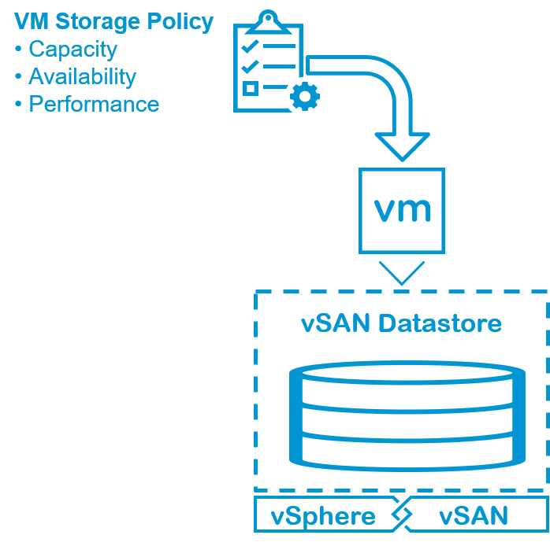
VM Storage Policies
Storage policies define how objects that are included in a VM are stored.
Storage policies have the following characteristics:
Based on storage capabilities
Defined for a VM or disk at the time of deployment
Can be applied later
Can be changed at any time
Cannot be deleted if they are in use
Notes:
VM storage policies are a set of rules that you configure for VMs. Each storage policy reflects a set of capabilities that meet the availability, performance, and storage requirements of the application or service-level agreement for that VM.
You should create storage policies before deploying the VMs that require these storage policies. You can apply and update storage policies after deployment. A vSphere administrator who is responsible for the deployment of VMs can select policies that are created based on storage capabilities. Based on the policy that is selected for the object VM, these capabilities are pushed back to the vSAN datastore. The object is created across ESXi hosts and disk groups to satisfy these policies.

Slide 75
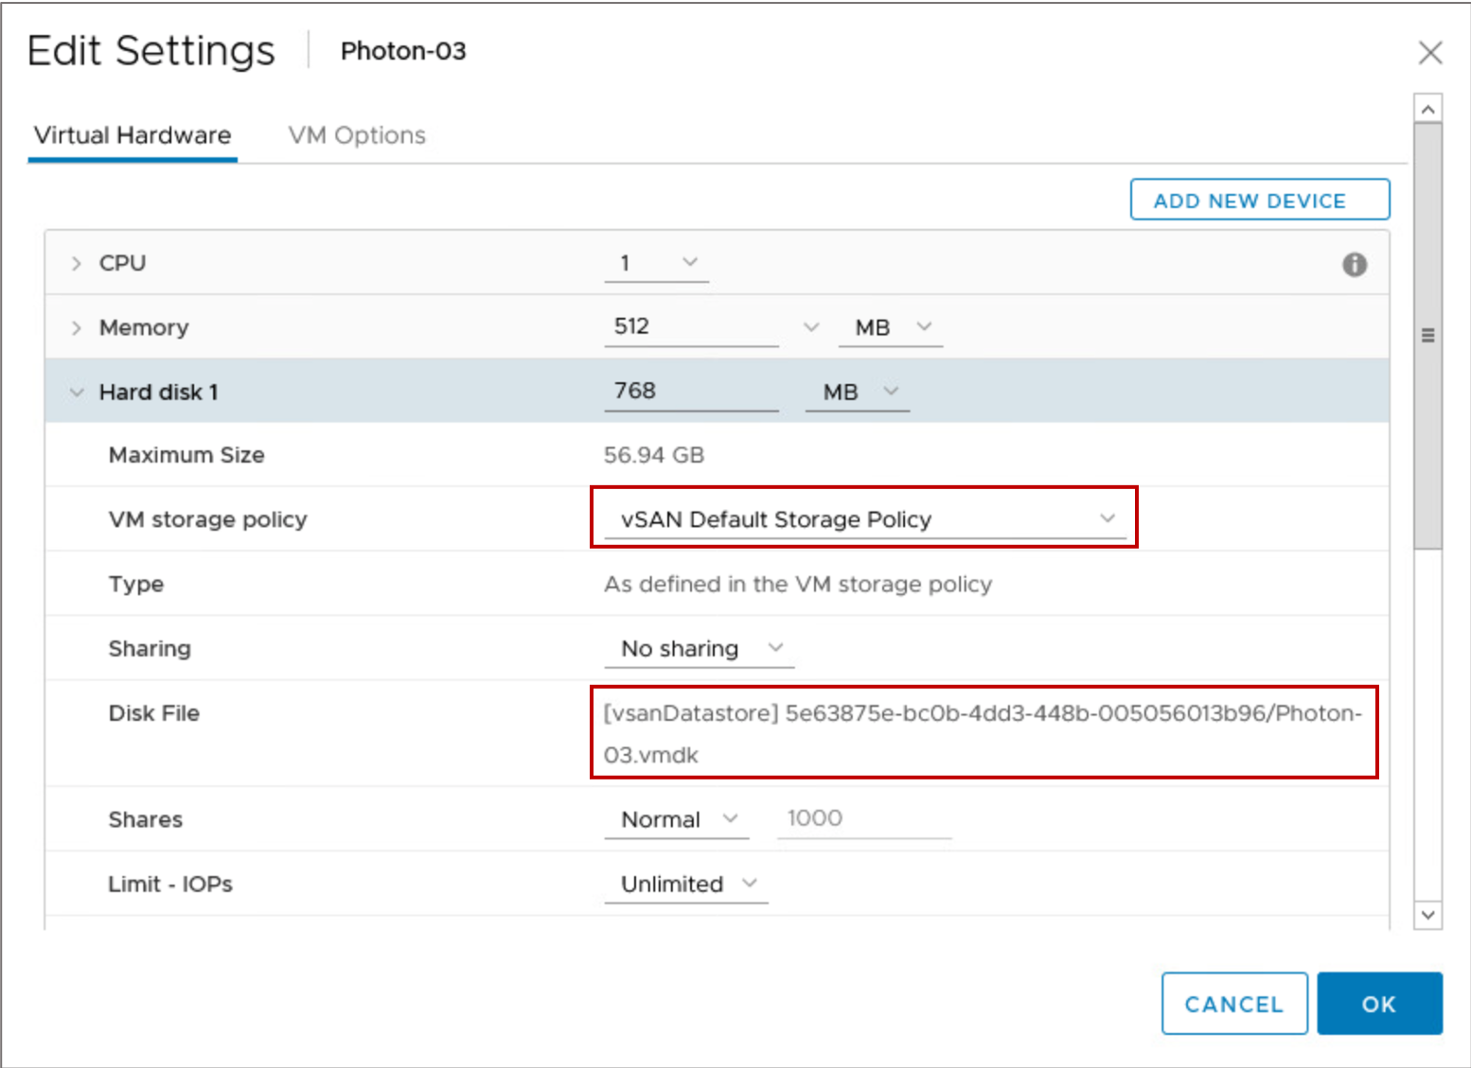
Viewing VM Settings for vSAN Information
The consumption of vSAN storage is based on the VM’s storage policy.
The VM’s hard disk view provides the following information:
A display of the VM storage policy
The location of disk files on a vSAN datastore

Slide 76
Lab 15: Using a vSAN Datastore
View a vSAN datastore configuration and a virtual machine's components on the vSAN datastore:
View a vSAN Datastore Configuration
View the vSAN Default Storage Policy
View a Virtual Machine on the vSAN Datastore

Slide 77
Review of Learner Objectives
After completing this lesson, you should be able to meet the following objectives:
Explain the purpose of a vSAN datastore
Describe the architecture and requirements of vSAN configuration
Explain the purpose of vSAN storage policies

Slide 78
Virtual Beans: Storage
As a Virtual Beans administrator, you are planning how to use NAS and iSCSI storage with vSphere:
For NAS storage, you can create one or more NFS datastores and share them across ESXi hosts:
Use the datastores to hold templates, VMs, and vCenter Server Appliance backups.
For iSCSI storage, you can create one or more iSCSI datastores and share them across ESXi hosts:
Use the datastores to hold templates and VMs.

Slide 79
Activity: Using vSAN Storage at Virtual Beans (1)
As a Virtual Beans administrator, you think that vSAN storage is the best option for the company's new storage requirements. What are the benefits to Virtual Beans of using vSAN storage?

Slide 80
Activity: Using vSAN Storage at Virtual Beans (2)
What are the benefits to Virtual Beans of using vSAN storage?
Benefits include (but are not limited to):
You can use the vSphere Client to manage the vSAN configuration. No separate user interface is necessary.
vSphere administrators do not need special storage hardware training.
You can use vSAN storage policies to define specific levels of service for a VM.
You can expand the vSAN capacity by adding one or more hosts to the vSAN cluster (also known as scale out).

Slide 81
Key Points
ESXi hosts support various storage technologies: Direct-attached storage, Fibre Channel, FCoE, iSCSI, and NAS.
You use VMFS and NFS datastores to hold VM files.
Shared storage is integral to vSphere features such as vSphere vMotion, vSphere HA, and vSphere DRS.
vSAN clusters direct-attached server disks to create shared storage designed for VMs.
Questions?

